Slide 1

Welcome to the 2026 Annual Meeting
Notes:
Welcome to the 2026 Annual Meeting. Reminder that if you haven’t voted, you have two hours to do so. Election ends at 8 p.m. EST. Please look for a message from Election Runner and if you can’t find it or don’t remember if you voted, please send a chat to Diane Cooner. And if you are still considering registering for the Training sessions over the next 6 weeks, we do have room for more participants!

Slide 2
2026 Annual Meeting Agenda
Establish Quorum
Approve 2025 Annual Meeting Minutes
Approve 2026 Meeting Agenda
2025 Annual Report Overview from the Chair and Committees

Slide 3
Agenda
2026 IOIA ANNUAL MEETING AGENDA February 19, 2026
7:00 p.m. EST Welcome and Business Meeting Call to Order by Joe Ward, Board Chair
7:05 p.m. Business meeting begins
Establish Quorum – 5 min.
Approve 2026 Annual Meeting Agenda – 5 min.
Approval of Minutes from the 2025 IOIA Annual Meeting (please review on IOIA website) – 5 min. Kathe Purvis
Annual Report Overview from the Chair – 40 min.
8:00 p.m. Break, Voting closes, Door Prize Drawings (must be present to win)
5) Treasurer’s Report – Allan Benjamin, Treasurer - 15 min.
a. 2025 Balance Sheet, Revenue and Expense Statement (vote for approval)
b. Presentation of the 2026 Budget
6) 2027 and 2028 AGM Locations and Format (open discussion) –15 min.
7) New Business, member discussions, topics decided during AGM (open discussion) - 25 min.
8) Announce New Board & Acknowledge outgoing BOD members – 5 min. Facilitator – Justin Hurley, Vice-Chair
Adjourn 9 p.m.

Slide 4
Annual Report 2025
Notes:
Welcome to the overview of the 2025 Annual Report – which will be posted on our website shortly.

Slide 5
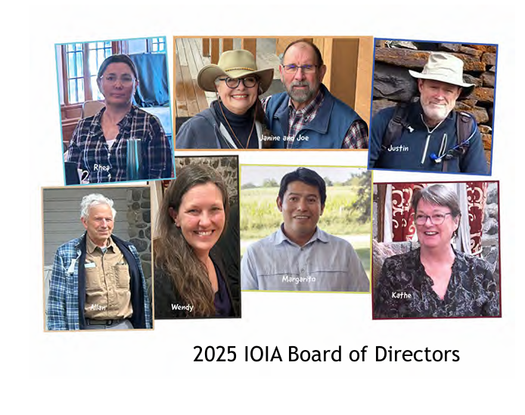
Thank you to a highly engaged and dedicated Board of Directors!
Notes:
In 2025, we reviewed our Strategic Plan, renewed our focus on development of a Communications Strategy and more robust fundraising. Special Thanks to Janine for adding a year to her term to provide counsel as Special Past Chair.
We pause for a few minutes to ask each of our board candidates to introduce themselves briefly. Full bios are posted on the Annual Meeting page of our website.
Do you also want to ask each BOD member to say hello?

Slide 6
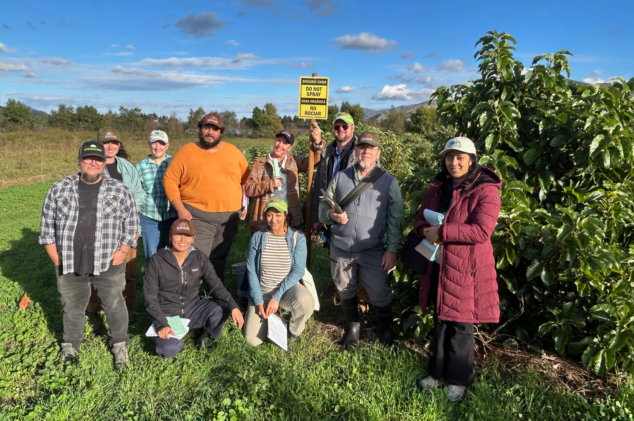
Mission Statement
Address issues and concerns relevant to organic inspectors
Provide quality inspector training
Promote consistency and integrity in the organic certification process
Notes:
If anyone asks, this is from the California Crop Inspection Training.

Slide 7
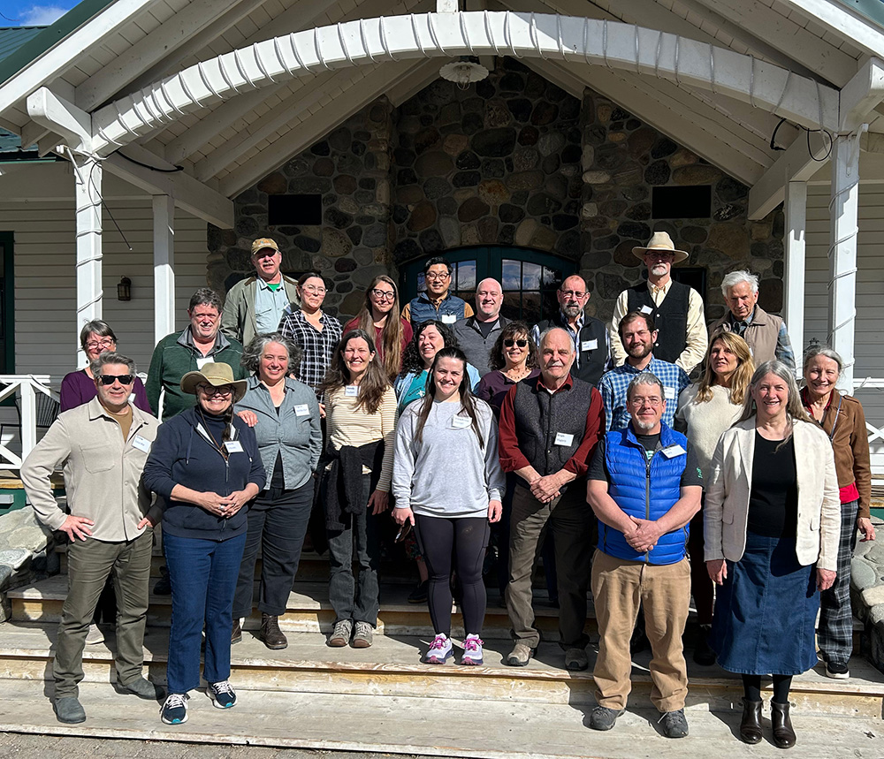
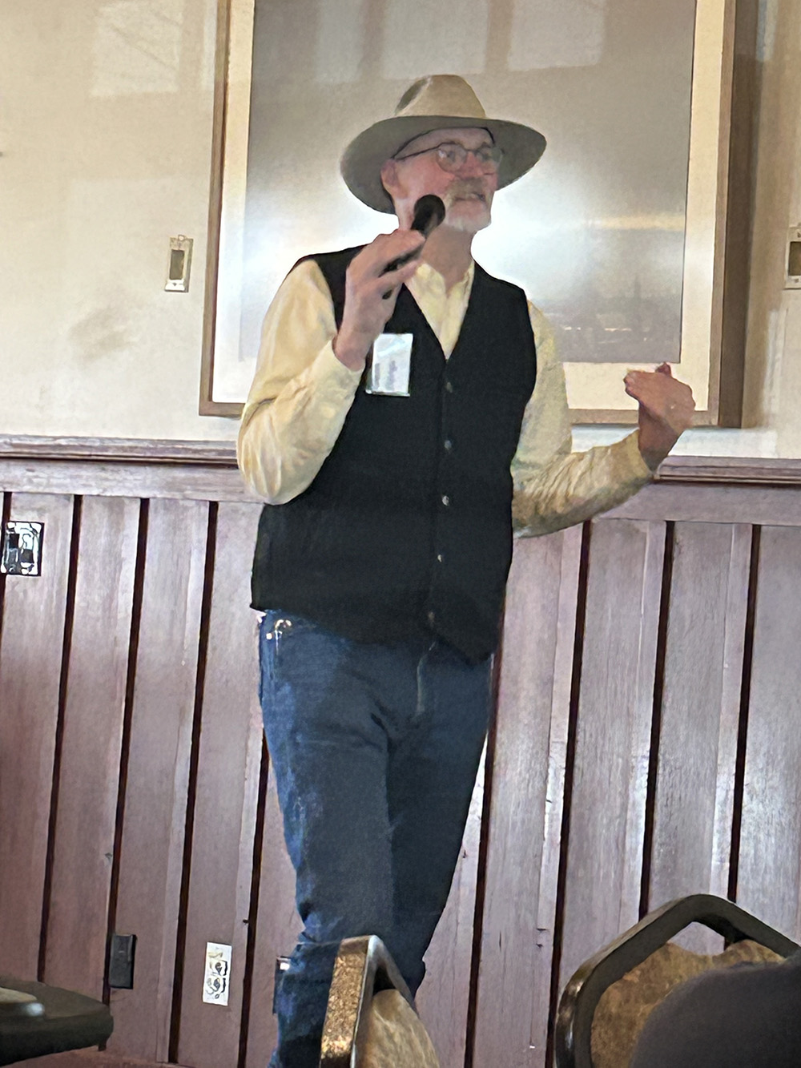
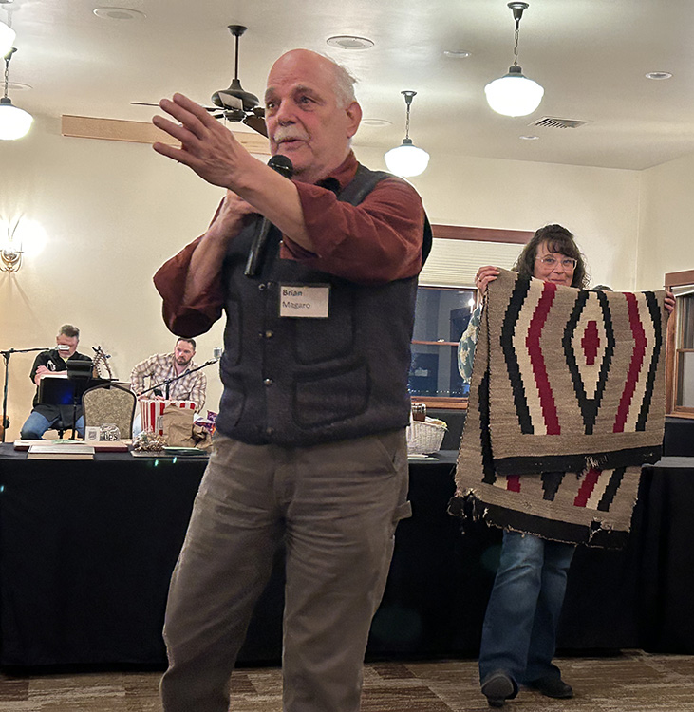
Our first AGM to go solo and in-person since 2019 was a success!
Chico Hot Springs, Montana
Notes:
We’ve surveyed our membership over the past few years and it is clear that our members value in-person annual meetings. It isn’t feasible to have one every year, but a tentative goal is to have one every 2 years. Choosing the location for next year is on the agenda today.

Slide 8
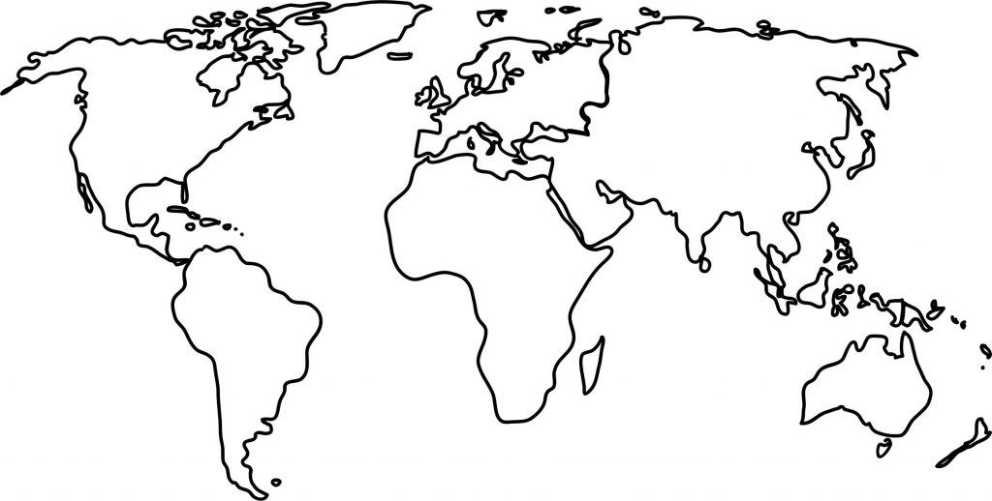
Membership – by the numbers
IOIA is INTERNATIONAL –
IOIA worked with the Asia Pacific Committee to achieve a training agreement.
IOIA was at the Guelph Organic and Canada Health Food Association conferences in Canada.
IOIA worked with AgriVita and SENASA to develop Spanish language training for the Peruvian government, funded by Switzerland.
4
284
14
in
Countries
Languages of Trainings
Members
Notes:
About half of our members are Inspectors and about half are Supporters.

Slide 9
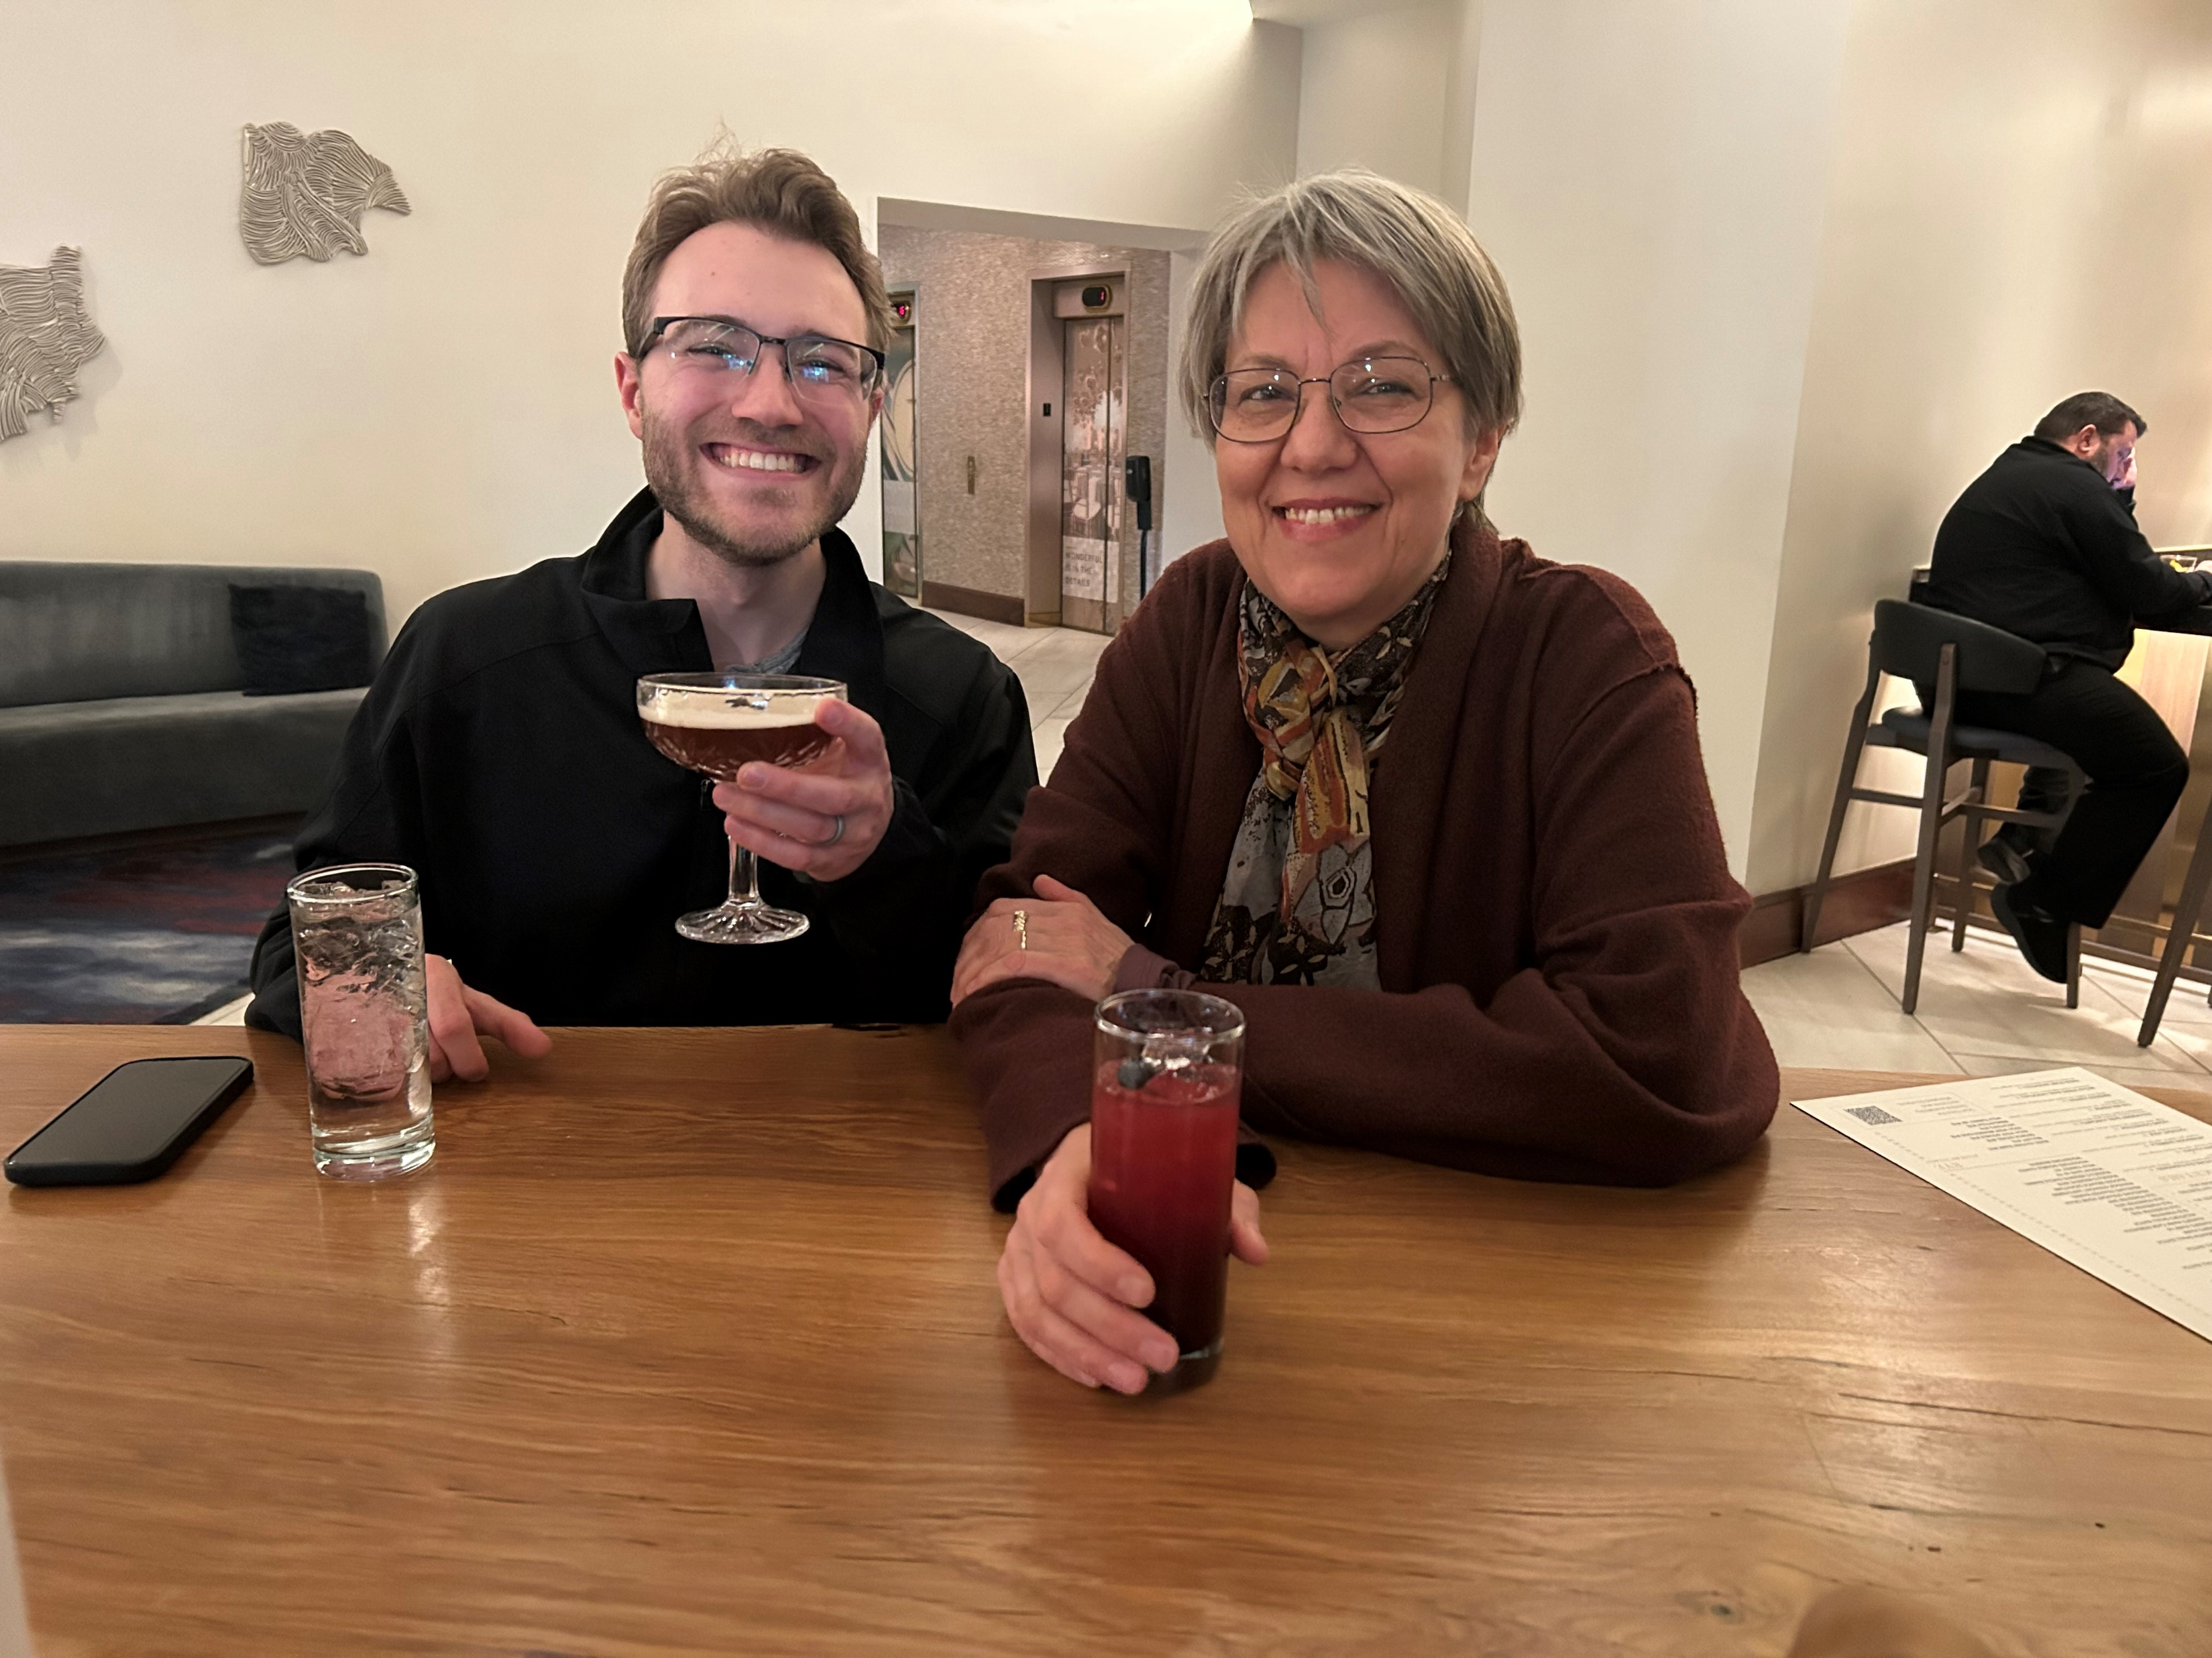
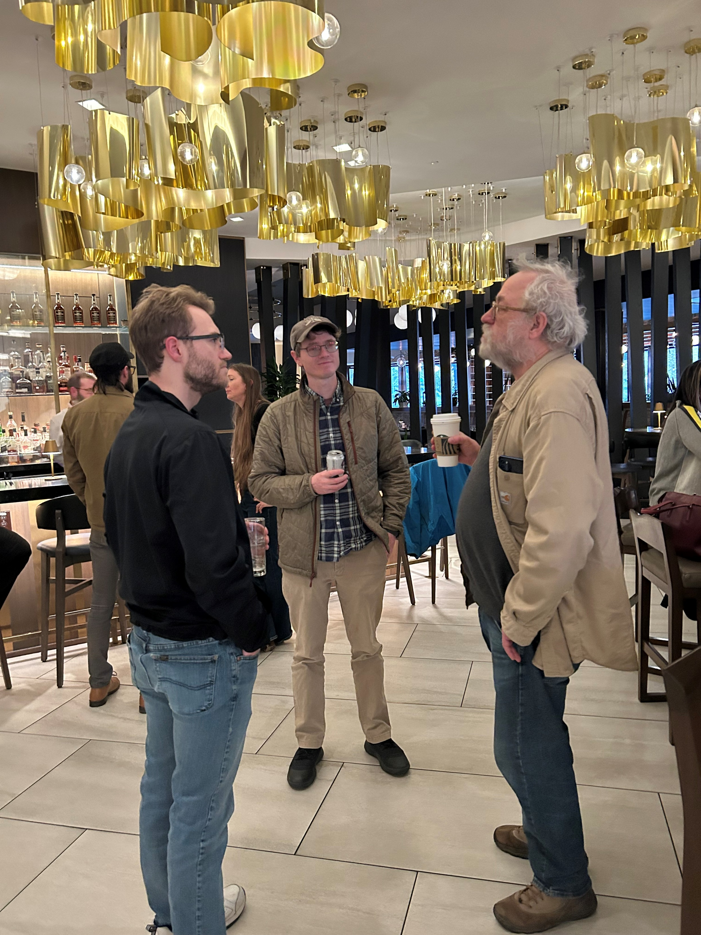
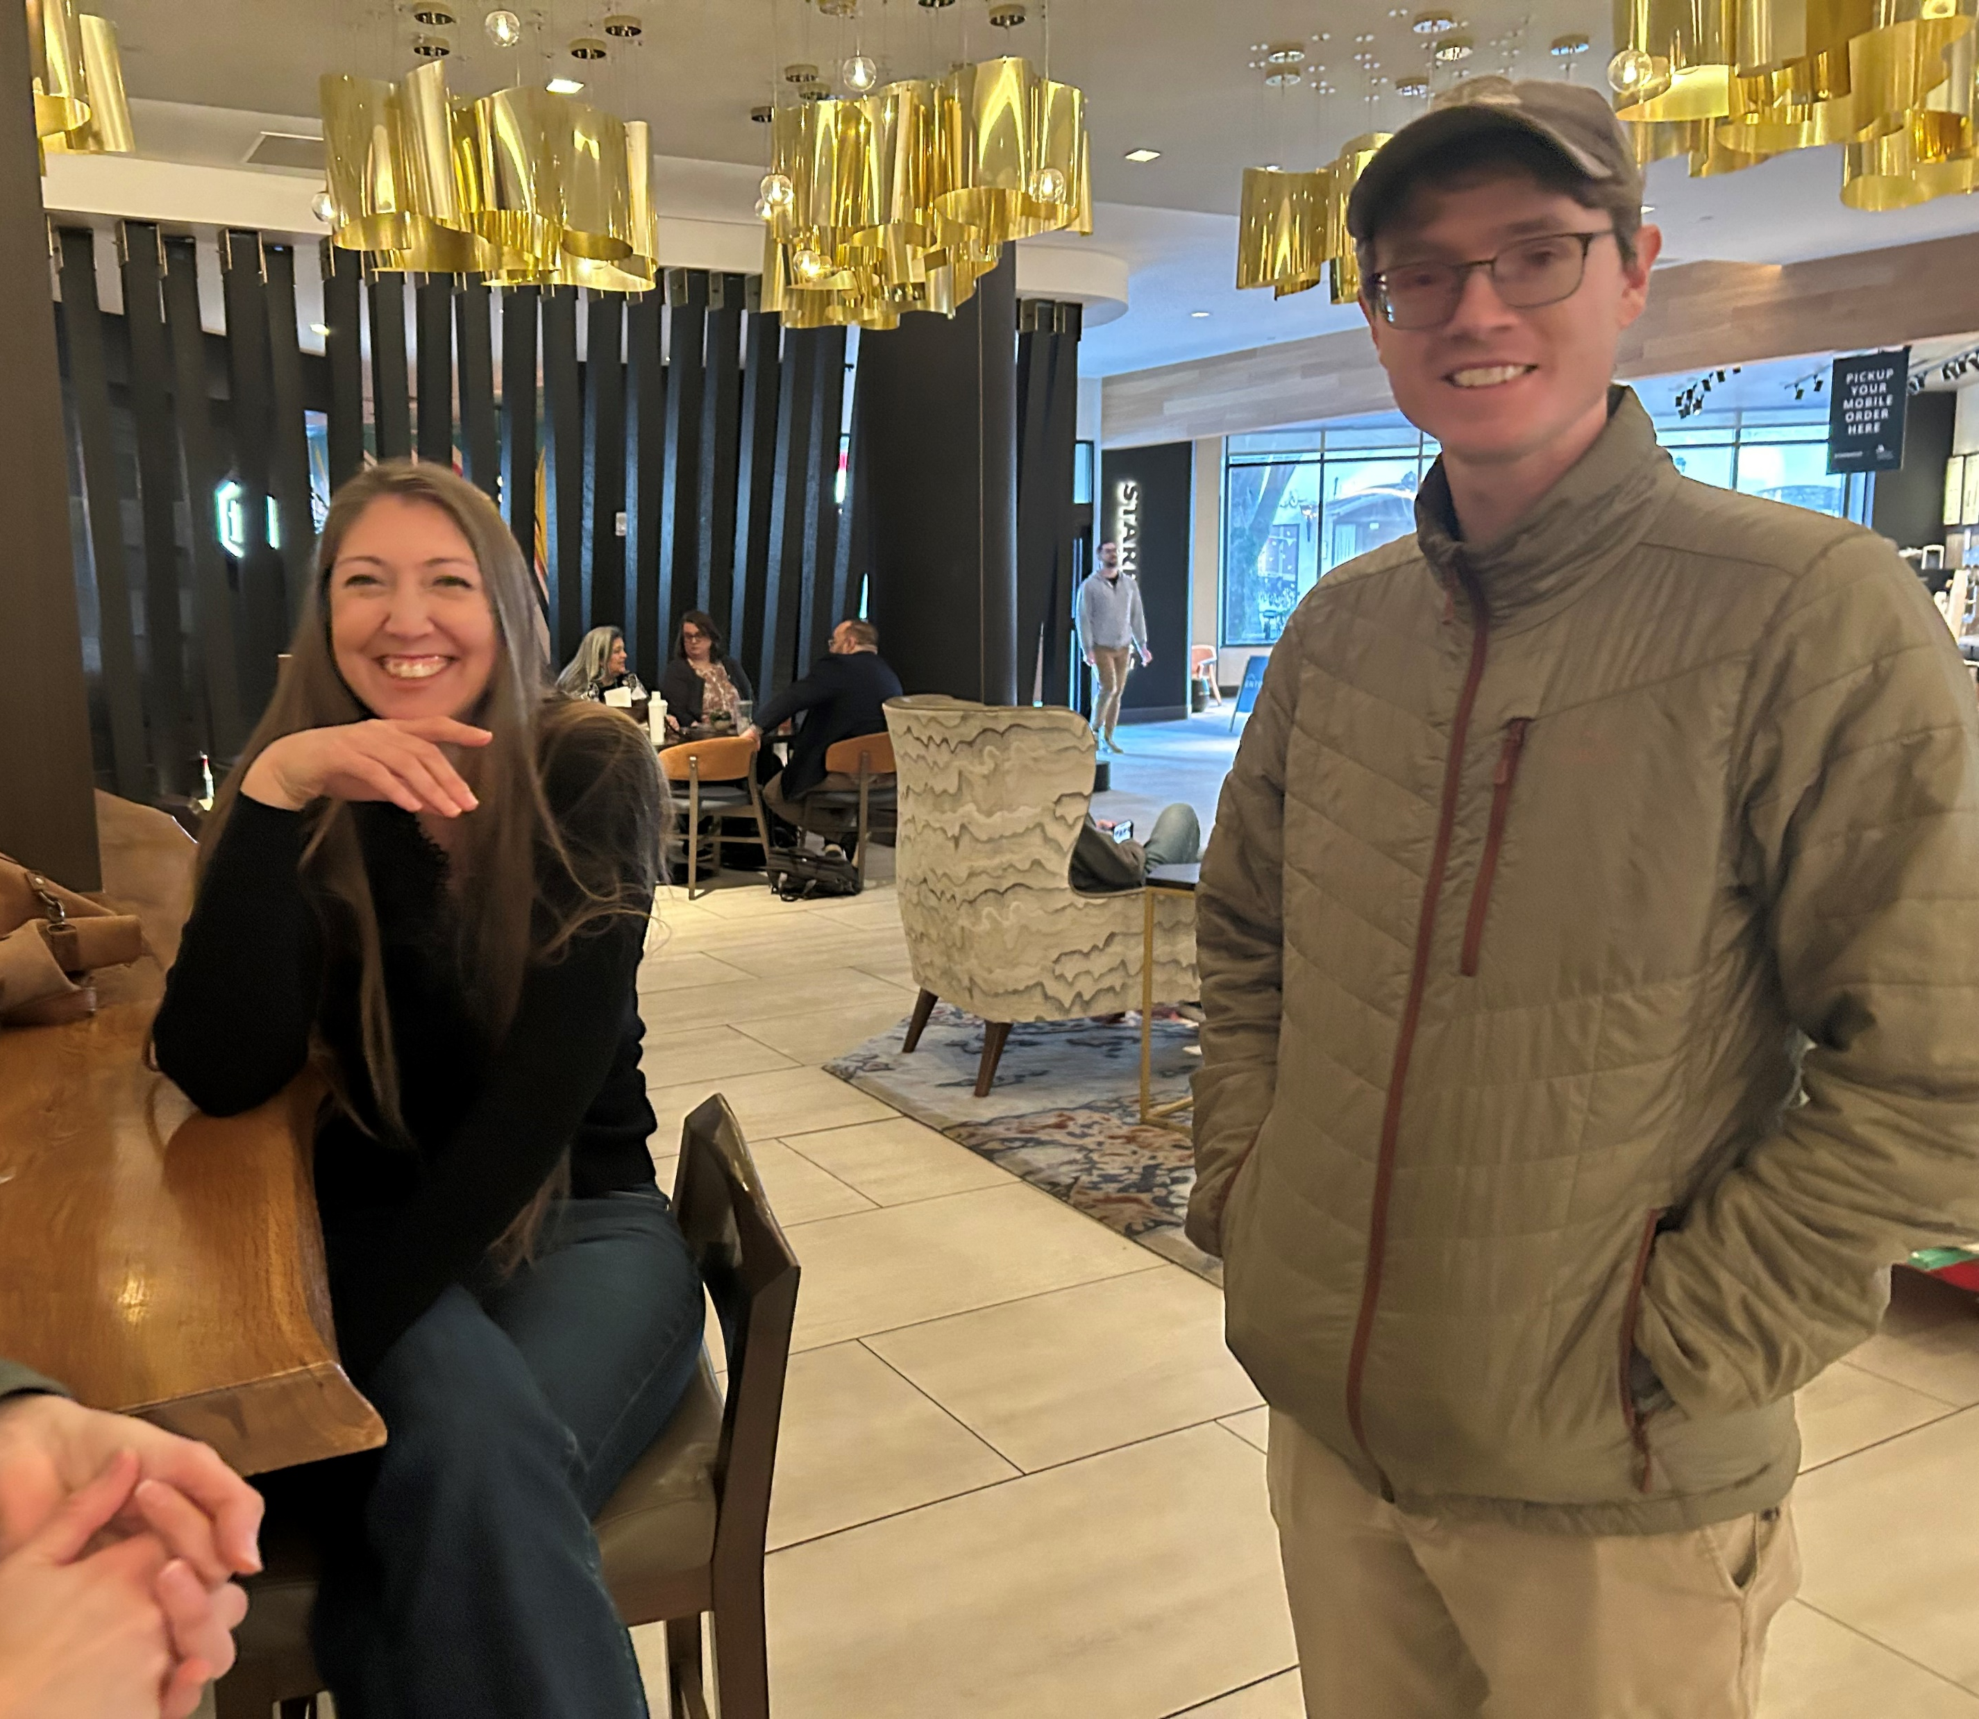
Membership – Networking Opportunities
Meet & Greet – Richmond, Virginia at ACA
Notes:
While we didn’t officially partner with ACA on training for our Annual Meeting, we strive to organize a social event in conjunction with ACA. Based on the popularity of the Richmond event, we did the same in Albuquerque this January. Development Director Drew Gourdie participated in key industry events including the Guelph Organic Conference, Expo West, and CHFA in Vancouver.

Slide 10
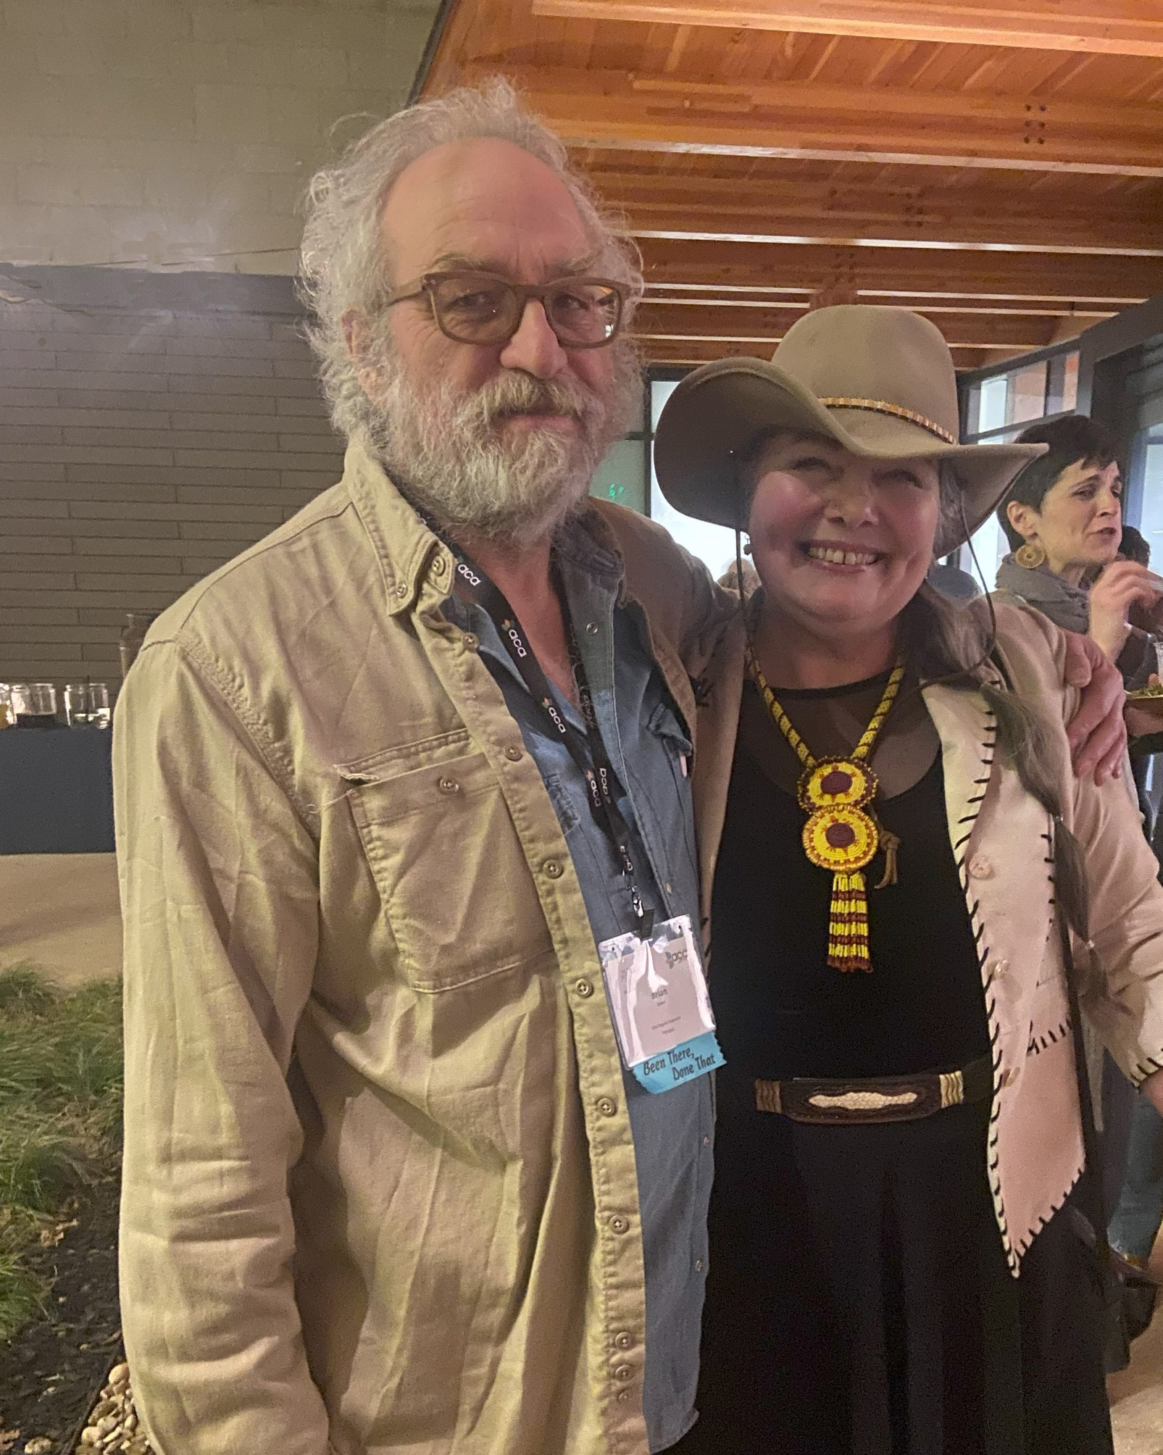
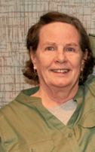
Membership – Policy
Committee & Ethics Committee
The Ethics Committee Reviewed all IOIA Complaint Investigation Procedures.
IOIA Codes of Ethics and Conduct were updated.
The Policy Committee met on Risk-based Inspections and other topics.
Notes:
Thank you to the Ethics Committee! To serve on the Ethics Committee, one must have had to serve at some point on IOIA’s Board of Directors or Accreditation Committee. Brian Baker chairs.
Kate Newkirk chairs the Policy Committee, assisted by Rachel Myers as our Policy Comment Committee Coordinator.
A favorite IOIA photo from 2024 when Brian and Janine were both on the IOIA Board and at the Alamo.

Slide 11
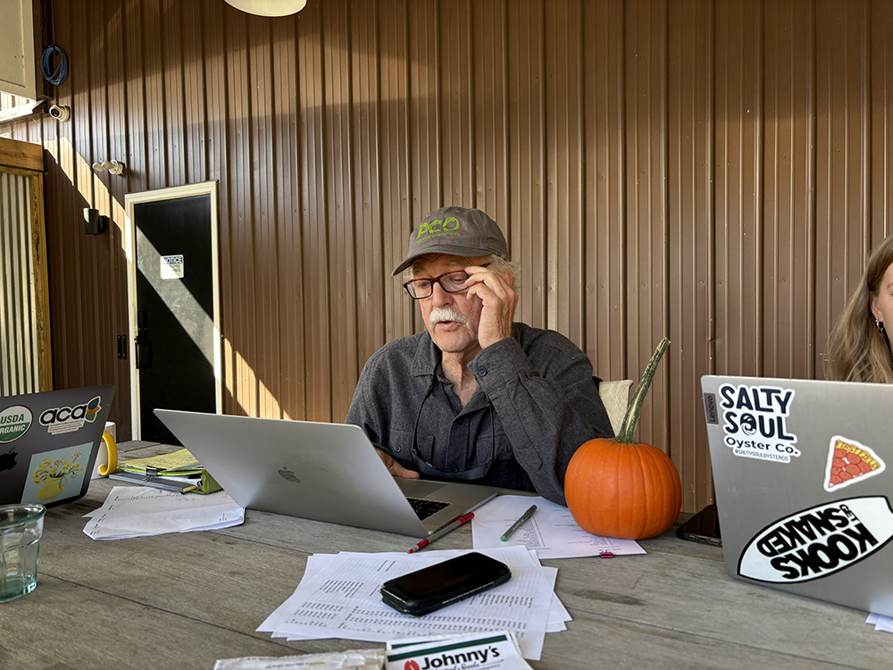
Membership – Bylaws Committee
In 2025, IOIA’s Bylaws Committee worked hard to complete an update and modernization of our Bylaws.
The amendment was discussed at the AGM, sent out to members for comment, and finally sent to a vote.
Excellent online voter turnout! About one-third of our eligible voting members voted. The vote was overwhelmingly “yes”.
Notes:
Huge thank you to Committee Chair, Al Johnson; BOD liaison Justin Hurley; and committee member Leonard Pollara for doing the work to bring to the bylaws modernization to fruition. Here’ s Al, still doing inspections, about 34 years after he was the 2nd member to plunk his dues down to found IOIA.

Slide 12
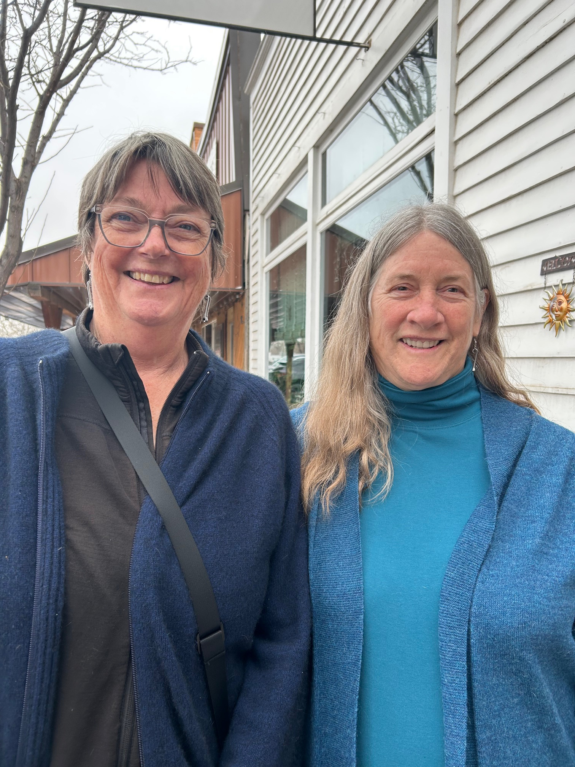
Membership – Asia Pacific Committee
Mission Statement – 2025 and onwards
IOIA APC understands the need for organic practitioners to take a wider world view, and to consider and understand associated concepts such as climate change, carbon sequestration and social justice.
IOIA APC will provide services to organic inspectors and other interested persons by delivery of information sessions and formal training, both online and in person
to promote
Harmony among the various organic standards
Contextual interpretation of applicable organic standards
Understanding of associated concepts for environment and community
Notes:
Suggested speaker notes – Kathe is here to give us an Asia Pacific Committee report. While she was on the board, she twice traveled to the US (a big commitment) to attend annual meetings.
After her report – thank you for your extraordinary service in the role of Secretary to the board, engagement with the Asia Pacific Committee, and work as an IOIA trainer for the Social Accountability standards, EU regulations, and Grower Group training both online and in-person. Thank you for 3 years of hard work on behalf of us all!

Slide 13


Membership – Representation and Advocacy
We went and represented YOU… as the voice of inspectors at – Guelph Organic Conference, CHFA in Vancouver, Organicology in Oregon, Expo West in California, High Plains Organic Conference in Wyoming.
IOIA was one of many organizations and individuals who wrote letters in solidarity urging management to voluntarily recognize the Oregon Tilth Workers United (OTWU).
We renewed regular bi-monthly meetings with Dr. Jenny Tucker, NOP.
We worked via a TOPP project with Organic Farmers Association to develop a new resource, the Organic Career Network.
Our BOD researched membership benefits including car rental benefit and affordable insurance.
Our ED Serves on the IFOAM North America board.

Slide 14
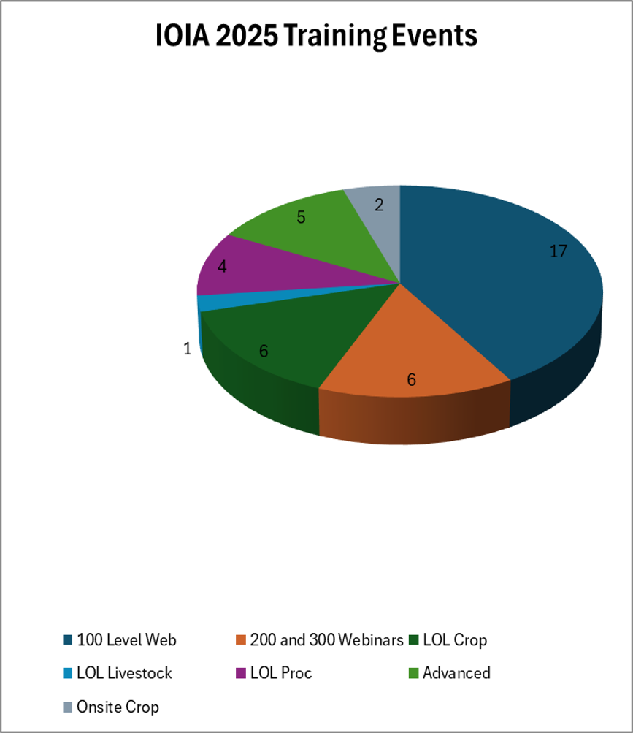

551
46
13
People Trained
Events
Partners & Cosponsors
Notes:
IOIA’s International Training Manager works with cosponsors such as NGOs, certification agencies, universities, and governments to make training accessible around the world. Each year, IOIA fields dozens of inquiries for trainings that may take years to come to fruition or might not develop at all. IOIA is currently working with Florida Organic Growers to develop training in-person in Florida for the Southeast TOPP region. We are grateful to AgriVita and Luis Brenes for making Spanish language training reliably available in Latin America including Puerto Rico.

Slide 15
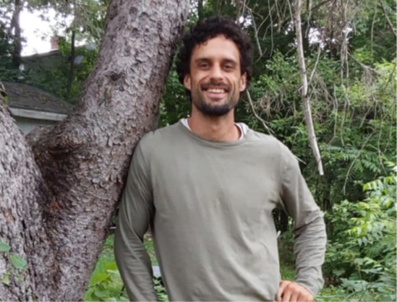
Training - Webinars
^{New Webinars in 2025}
^{Maple Syrup Inspection}
NRCS Assistance for Conservation on Organic Farms
Fraud on Organic Farms – with SOS
^{Coming Soon! With OIC}
Supply Chain Traceability Audits
Inspecting Transloader Facilities
^{John Welton, Maine}
^{Maple Syrup Trainer}
Notes:
Webinars are our most popular format, with one happening about every two weeks. Shout-out to IOIA-trained MOFGA inspector, John Welton, who put together our new maple syrup webinar. Claire Ackroyd, retired inspector assisted. We are exploring offering this as a self-directed course. Note that we will have at least 2 new webinars in 2026, working with the Organic Integrity Coperative.

Slide 16
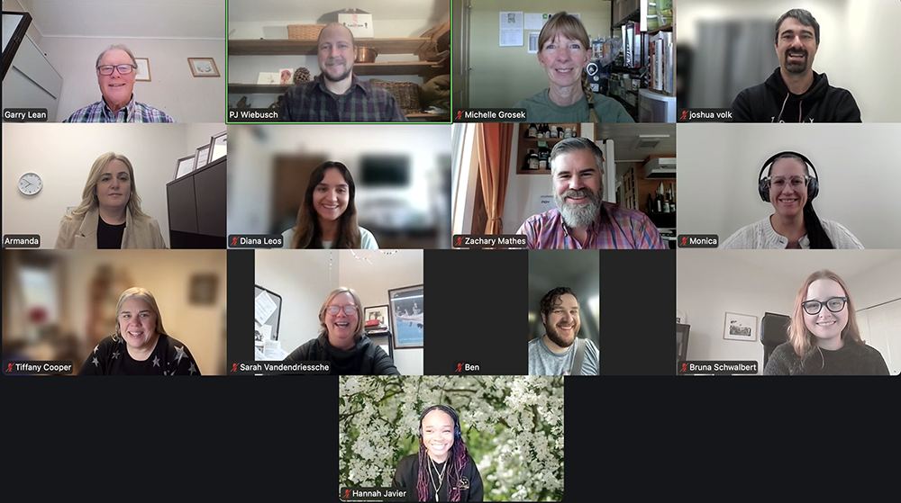
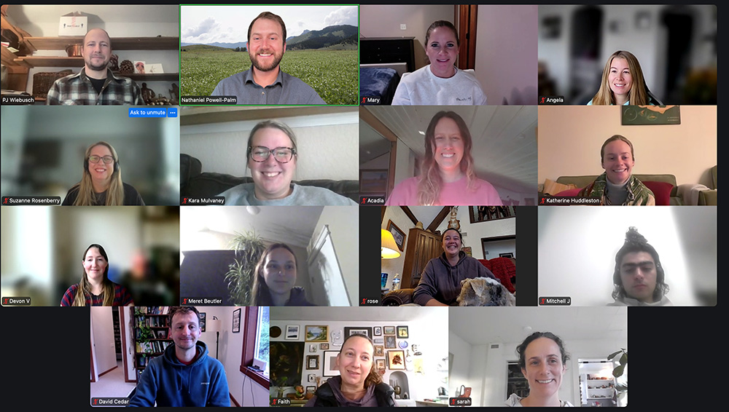
Training – Live Online
Notes:
Most Basic Training in the US and Canada is happening Live Online with one of our experienced trainers. About once monthly. 100 or more participants per year. Left – Basic Processing with Garry Lean and PJ Wiebusch. Right – Basic Crop with Nate Powell-Palm and PJ.

Slide 17

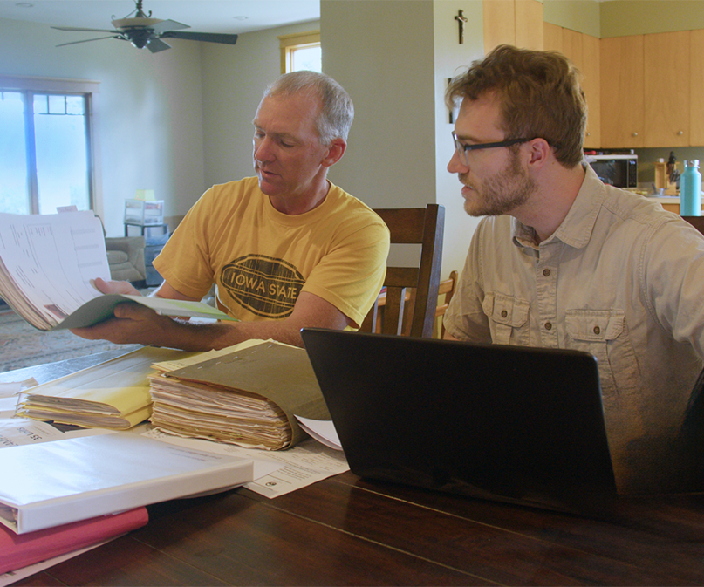
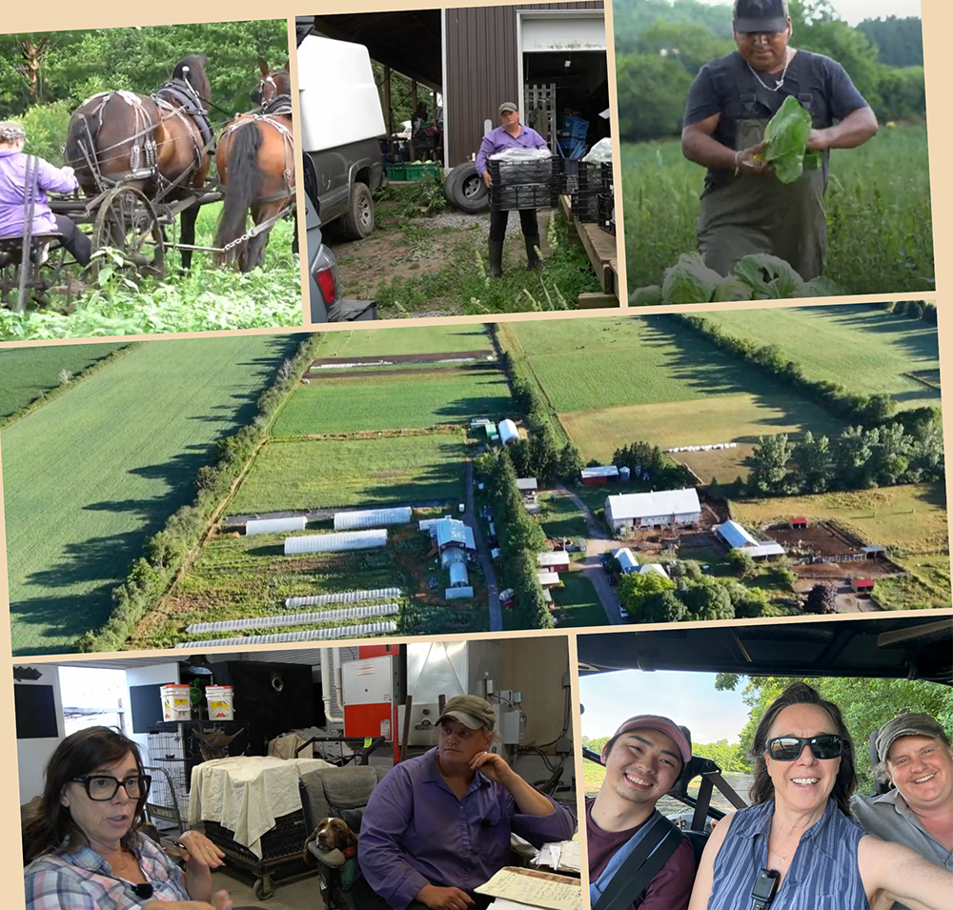
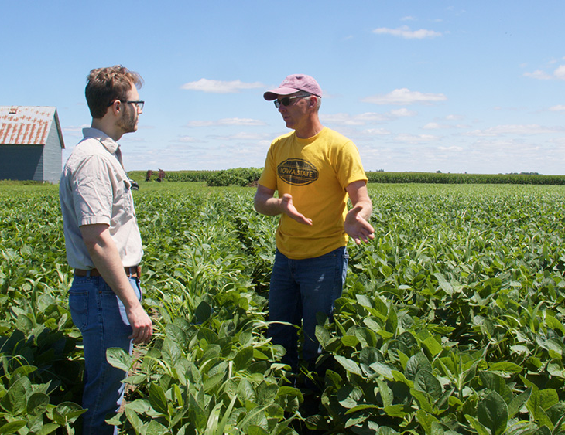
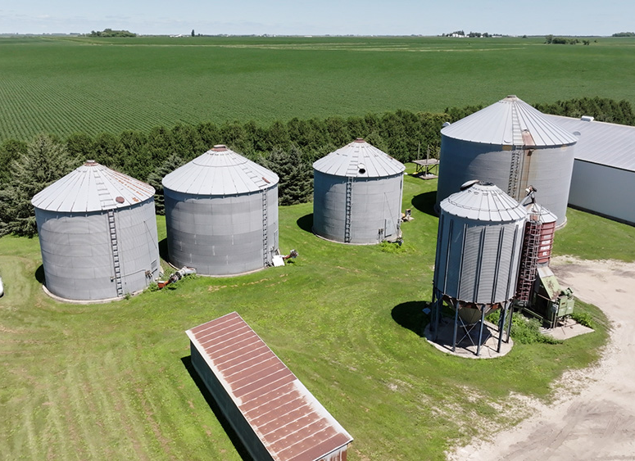
Training – 2 new Inspection Training Videos!
NOP - Iowa
COR - Ontario
Notes:
Huge shout-out to Matt Miller, who hosted the NOP shoot at his farm, with T Layhew as the “inspector”. Jessica Foot hosted in Ontario and Kym Snarr was our “inspector”. Both videos were filmed on the same day! Also big thanks to our videographers – SLAB Visuals in the US and Shinowa Okumura in Canada.
The NOP video has already been used in live online basic courses several times and will be used again next week.
The COR basic crop course has been delayed to July, so our new inspection video will launch then.

Slide 18
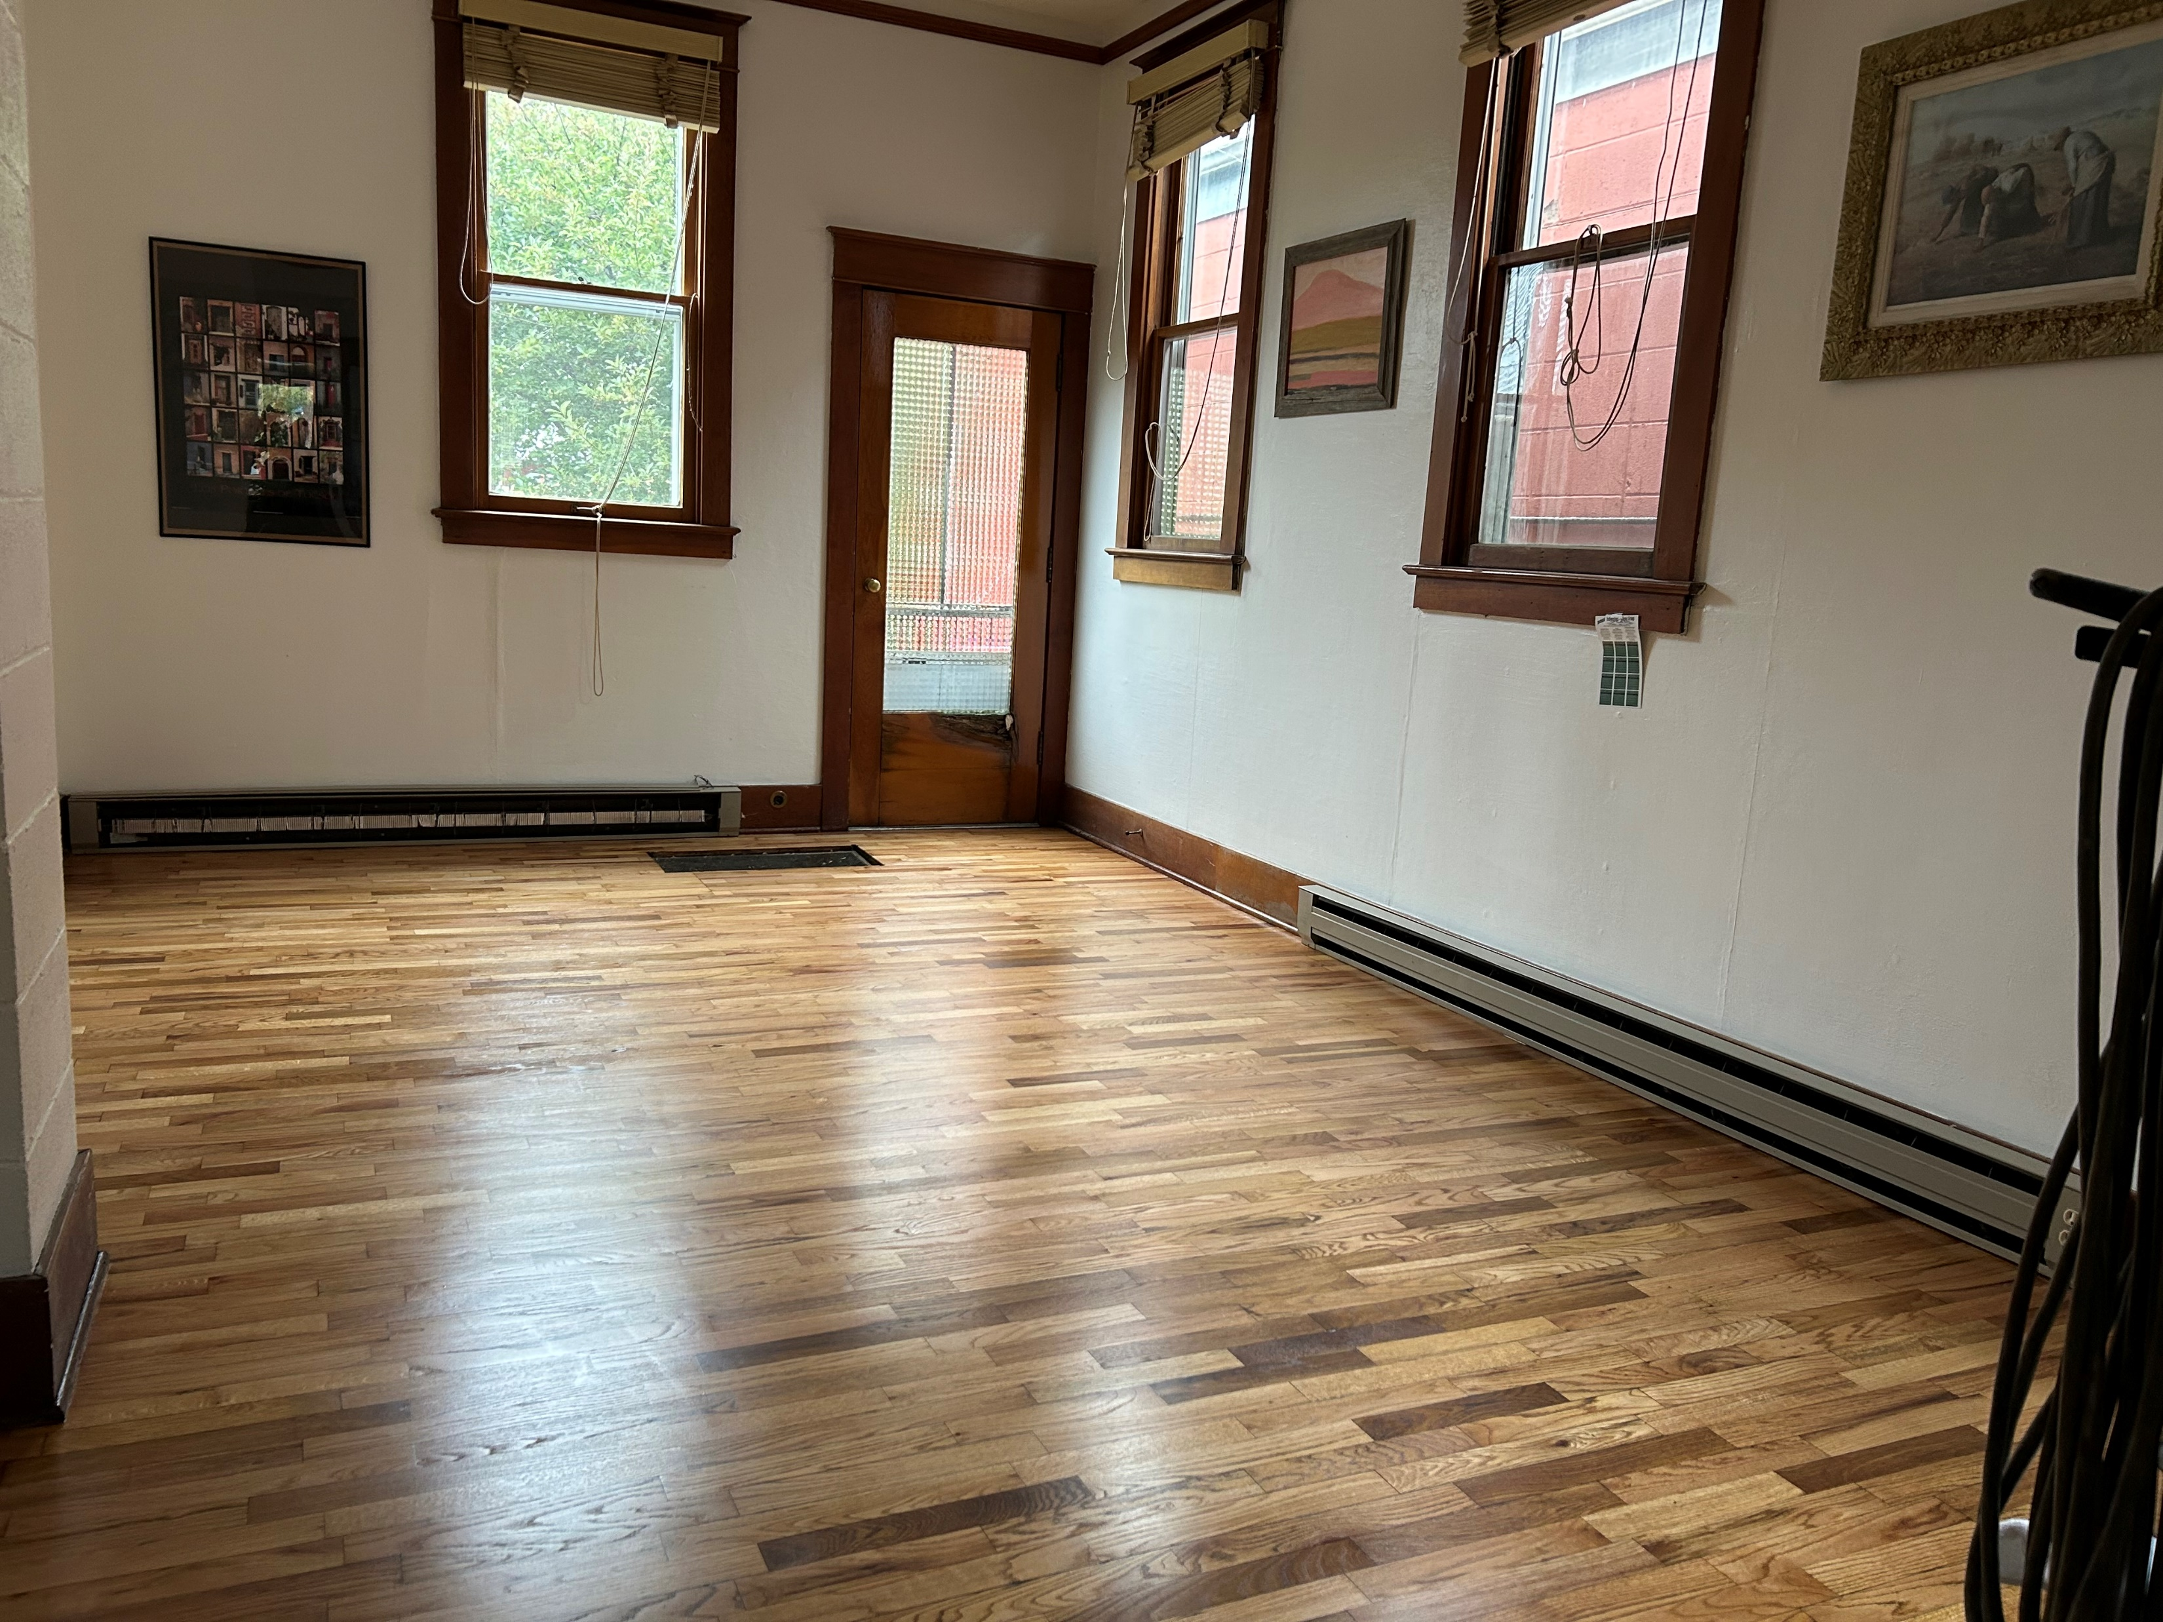
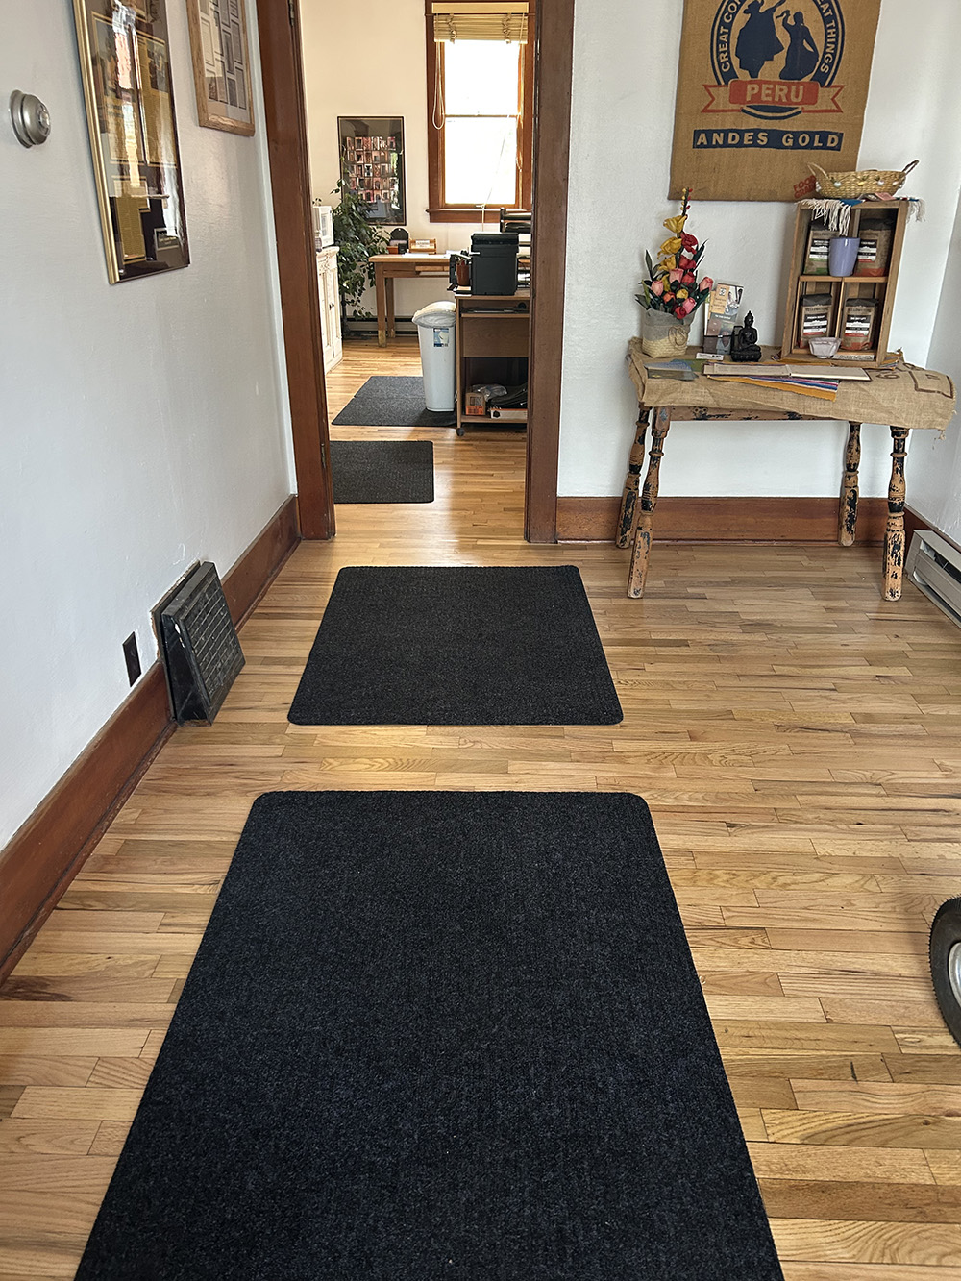
Office Project
Notes:
We received a $5000 grant from the Powder River Community Fund and used it to refinish the historic hardwood floors in the office,and painted the entire interior. The grant provided more than half of the cost of the update. Maintaining our asset! This year, we plan to paint the front of the building.
Special thank you to the Amsden family, who gifted us the building in 2007.
Anne Amsden and Margaret are shown here, as Margaret receives the deed. Sadly, we lost Anne this year at the ripe old age of 97 years. She was a vocal advocate for the environment and social justice.
As part of the grant requirements, we will have an open house in a few months and invite the community in to see the outcome of the project.

Slide 19
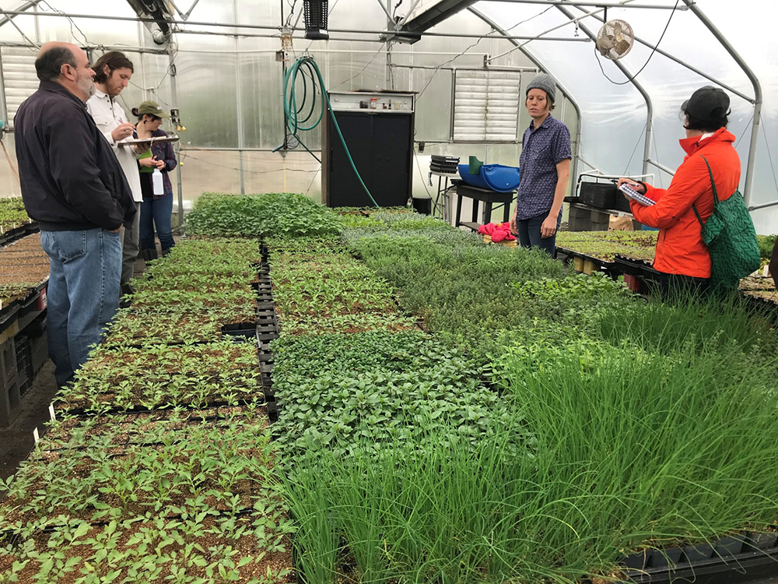
Hybrid Training
Notes:
Hybrid Trainings –IOIA’s newest model for basic training and one of our most popular. Participants complete part of the course online with a trainer, and then the remainder onsite. This model is especially popular in Japan.

Slide 20
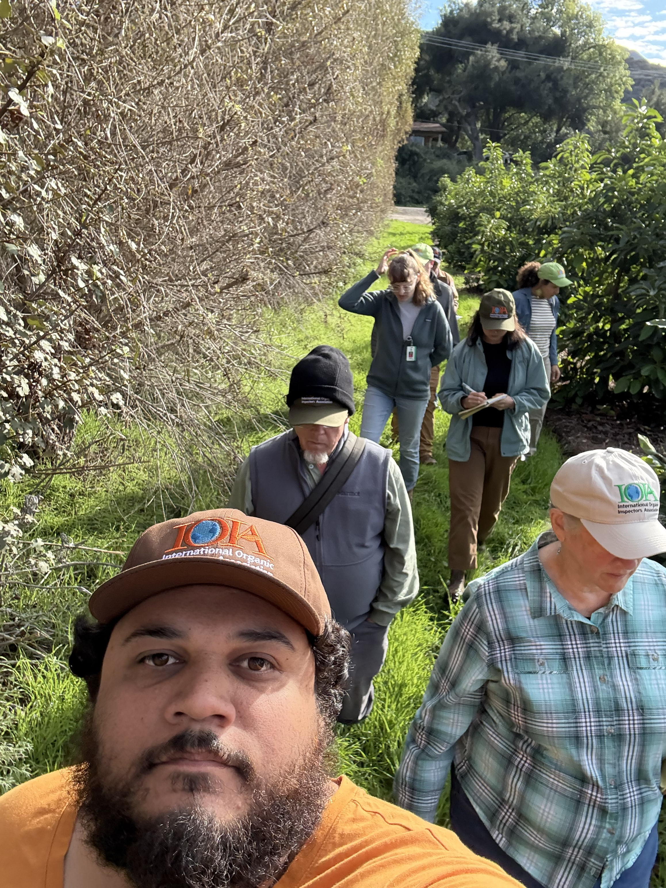
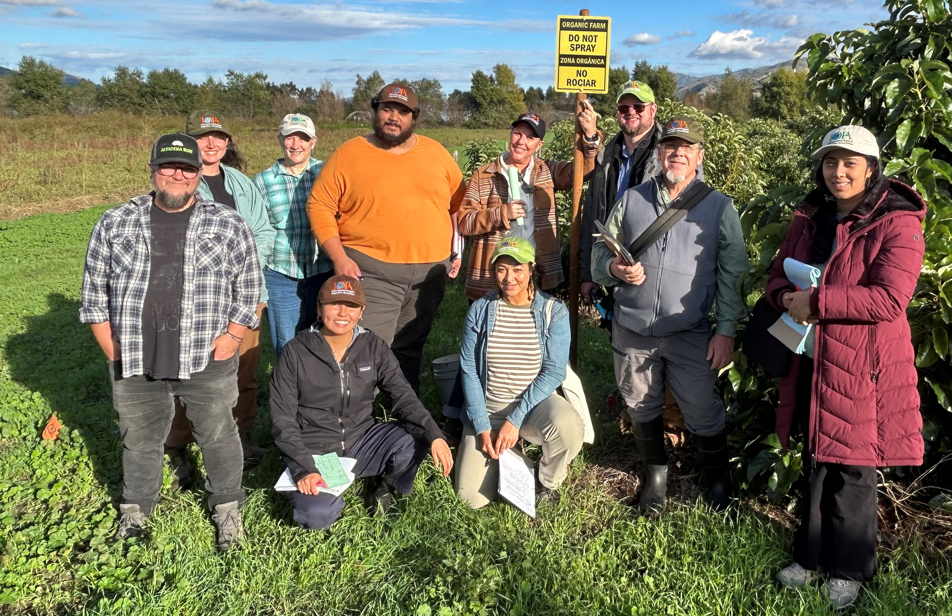
In-person Training-
California
Notes:
This was a collaboration of Rodale Institute and IOIA. Garth Kahl and Margaret were the trainers.

Slide 21
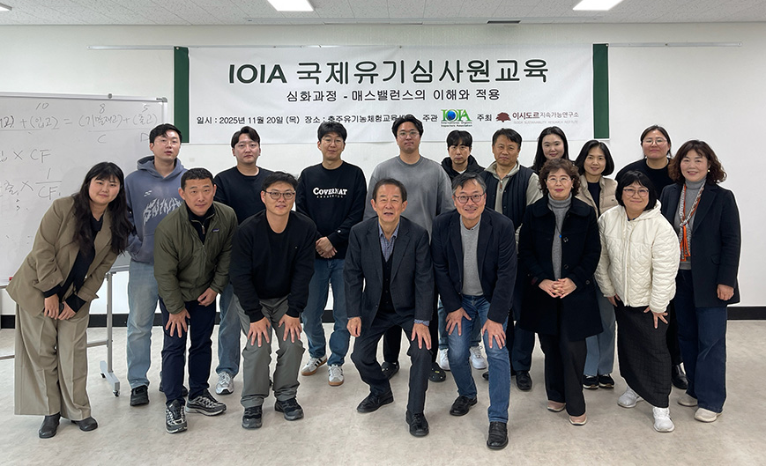
Advanced Training - Korea
Notes:
Advanced Audit Trail Training in Korea, with the Isidor Institute. See the “young” man in the front? Isidor has been working with 2005 with IOIA (now 20 years!). In 2025, IOIA finalized a Memo of Understanding, authorizing Isidor as IOIA’s official representative in South Korea.

Slide 22
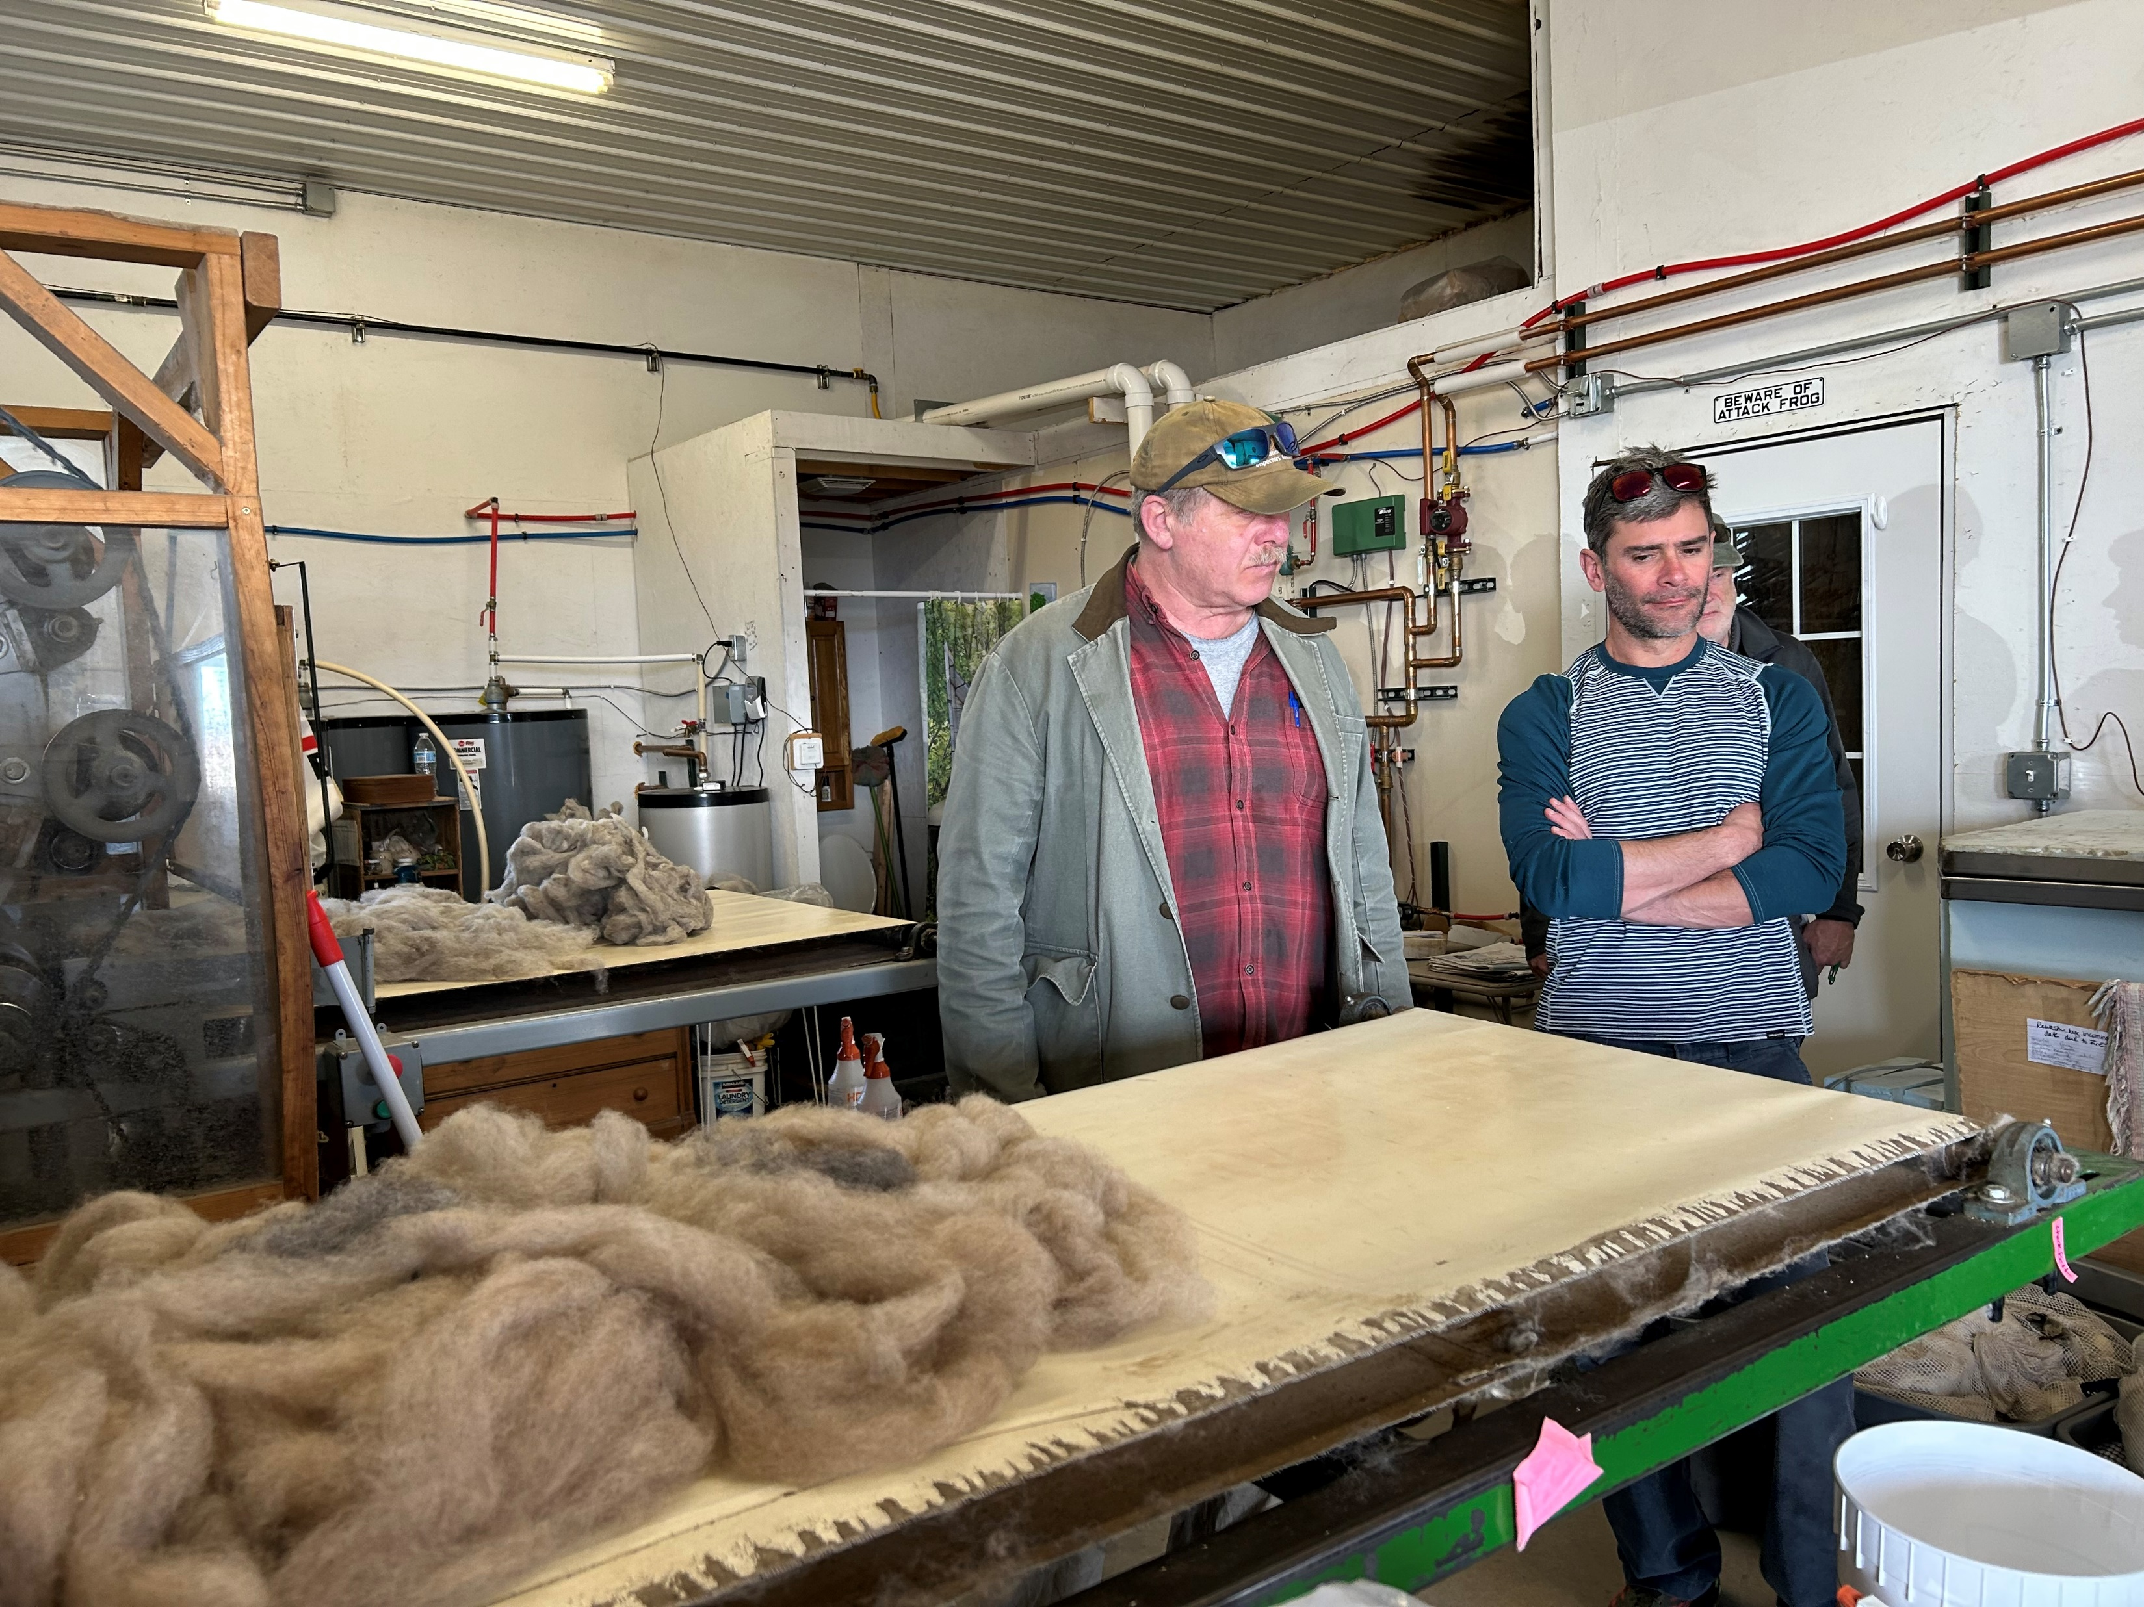
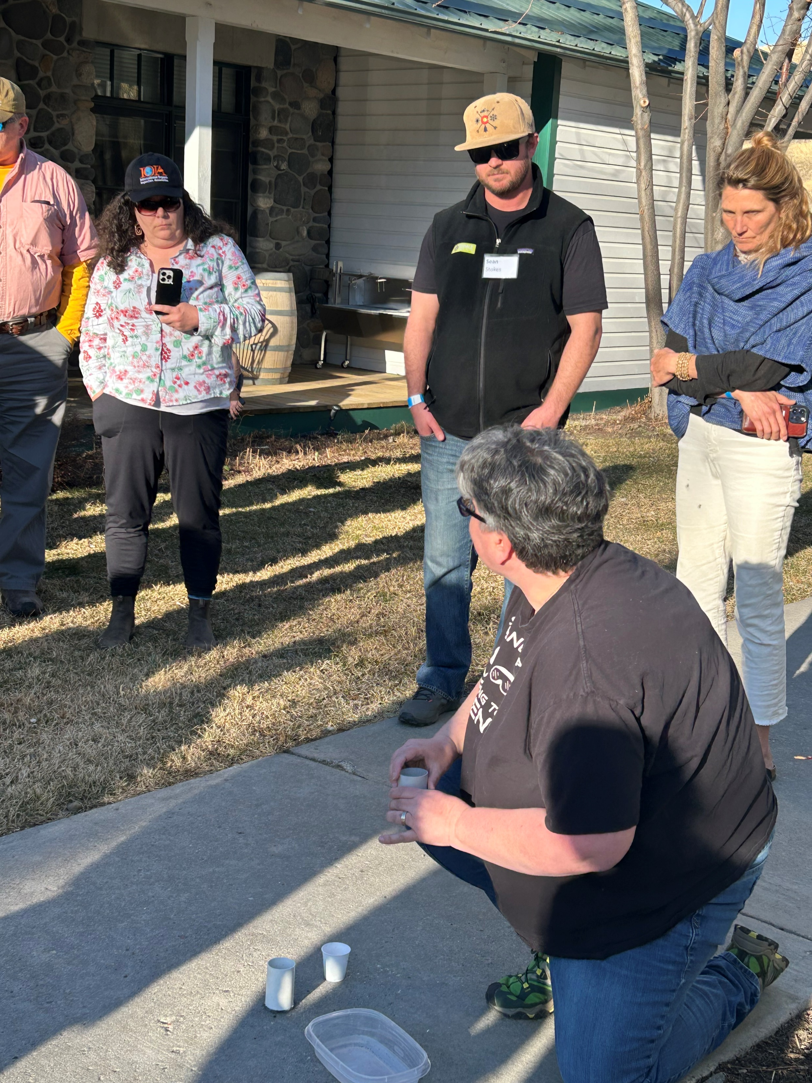
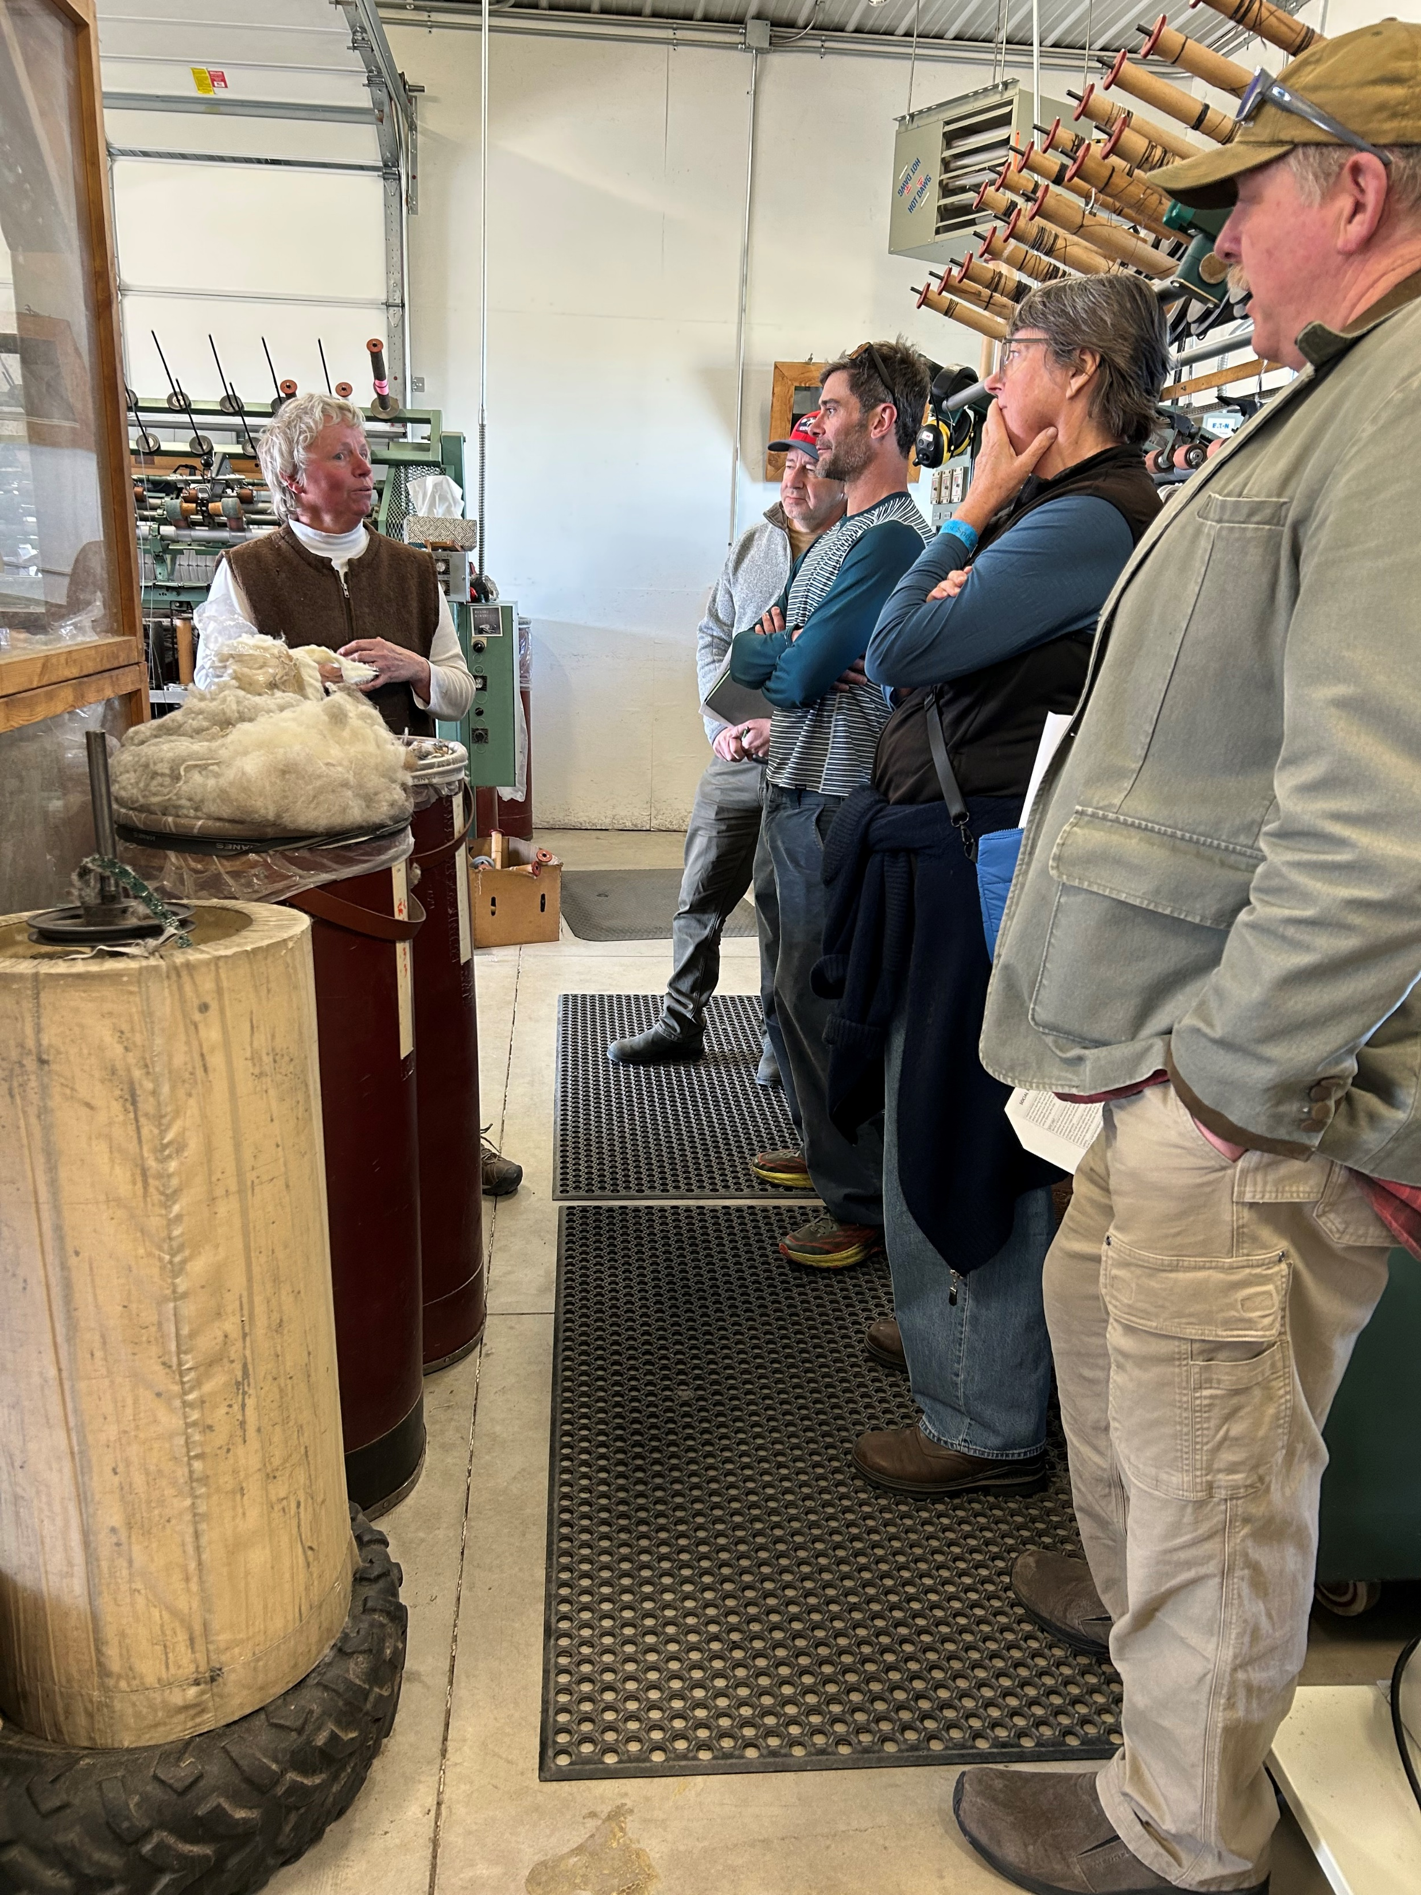
Advanced Training - MT
Notes:
At the advanced training in Montana, we partnered with the Organic Integrity Cooperative, Regenerative Organic Alliance, Rodale Institute, and Ryan Sitler of GOTS with Soil Health a focus and Kathe as trainer for Social Accountability Auditing, with a visit to a local wool mill.

Slide 23
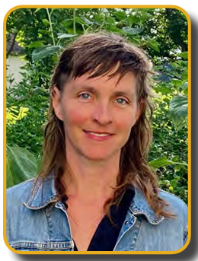
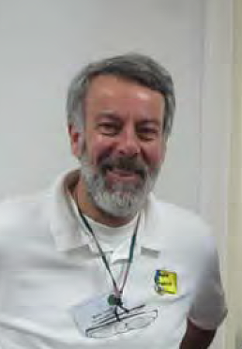
The first Durst Processing Apprenticeship Award
Notes:
Bob Durst, former board chair has endowed an annual processing mentorship award. 2025 had our first recipient. Cody Gieselman of Missouri.

Slide 24
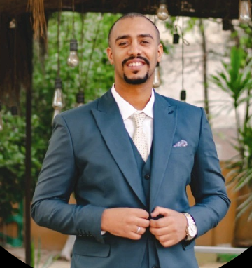
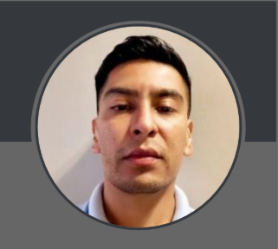
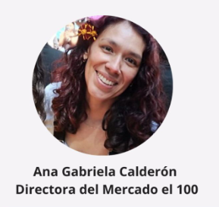
Career Development Awards
aka Scholarship Awards
Rutherford Award
Moetaz Mahdy, Egypt
Organic Community Initiative Award
Ricardo Tapia, Mexico
Reynaldo De la Rosa Award
Mexico
Notes:
IOIA gives 3 Career Development Awards. All 3 awards were given in 2025. Each one entitles the recipient to a full tuition waiver for a basic in-person or live online course. In 2025, we got a new Scholarship Committee Chair – Verónica Marquez Ledesma of Mexico!
!

Slide 25
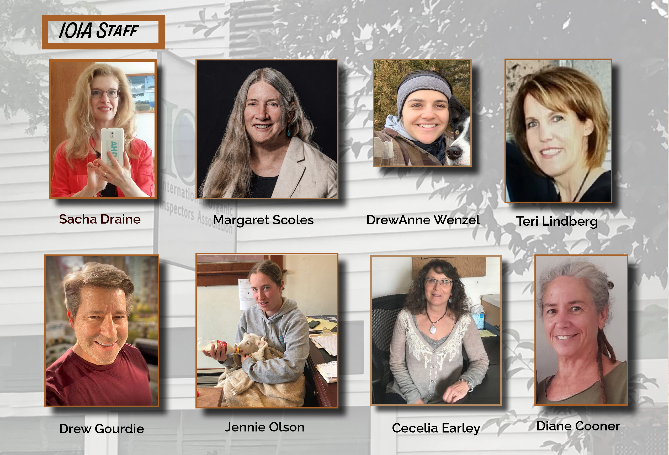
Cecilia Earley
Notes:
Sacha, our International Training Manager has achieved 20 years with us. Her 5 languages are an asset to IOIA and her work coordinating cosponsor-managed training. Margaret, on her 25th year with IOIA. DrewAnne is our Webinar Coordinator. Teri has been with us more than once, totaling about 12 years, managing the IOIA-managed training program. Jennie is the office admin. Cecilia has been bookkeeper 9 years. And Diane has the record – working with IOIA since 1994! – that’s more than 30 years! Of this staff, Margaret has the only full-time position. In 2025 Drew Gourdie left us after 2 years as Business Development Director.

Slide 26













In appreciation to our Partners!
We are grateful to be able to partner with so many longtime great organizations in organic!
IOIA wrote a draft Mentorship Guide for ACA which will be co-branded, also helped promote and support an ACA Fellowship Program for new inspectors, funded by Southwest TOPP.
Notes:
ED Margaret Scoles, Vice Chair Justin Hurley, and inspector member Darren Maum sat on a panel for new inspectors in Albuquerque for the Fellowship Program.

Slide 27
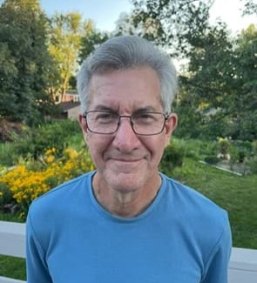
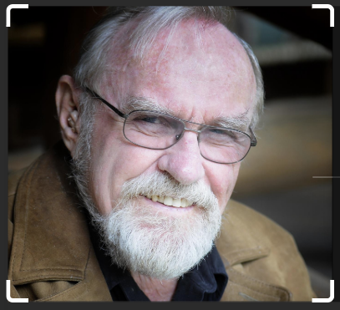
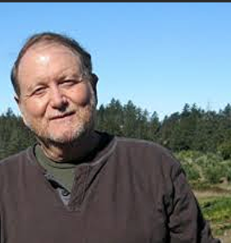
In Memoriam
Sam Welsch
Fred Kirschenmann
Michael Sligh
Notes:
A moment of silence?
Sam was an inspector member of IOIA, the founder of OneCert, a legendary voice of organic integrity and outspoken critic of certifying hydroponics. He built IOIA’s information management system in 2002-2003 that served us well for 20 years.
Fred was our first keynote speaker in 1993 and returned again in 2011 to do the same. A farmer, philosopher, and theologian, he had a big impact on IOIA’s early years. A gentle giant and a deep thinker.
Michael Sligh of the IOAS and the Alliance for Organic Integrity was our keynote speaker in 2000 and spoke on a panel “Conversation for a New Decade” in San Antonio just before the Covid pandemic hit. Another gentle giant, respected around the world.

Slide 28
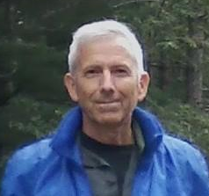
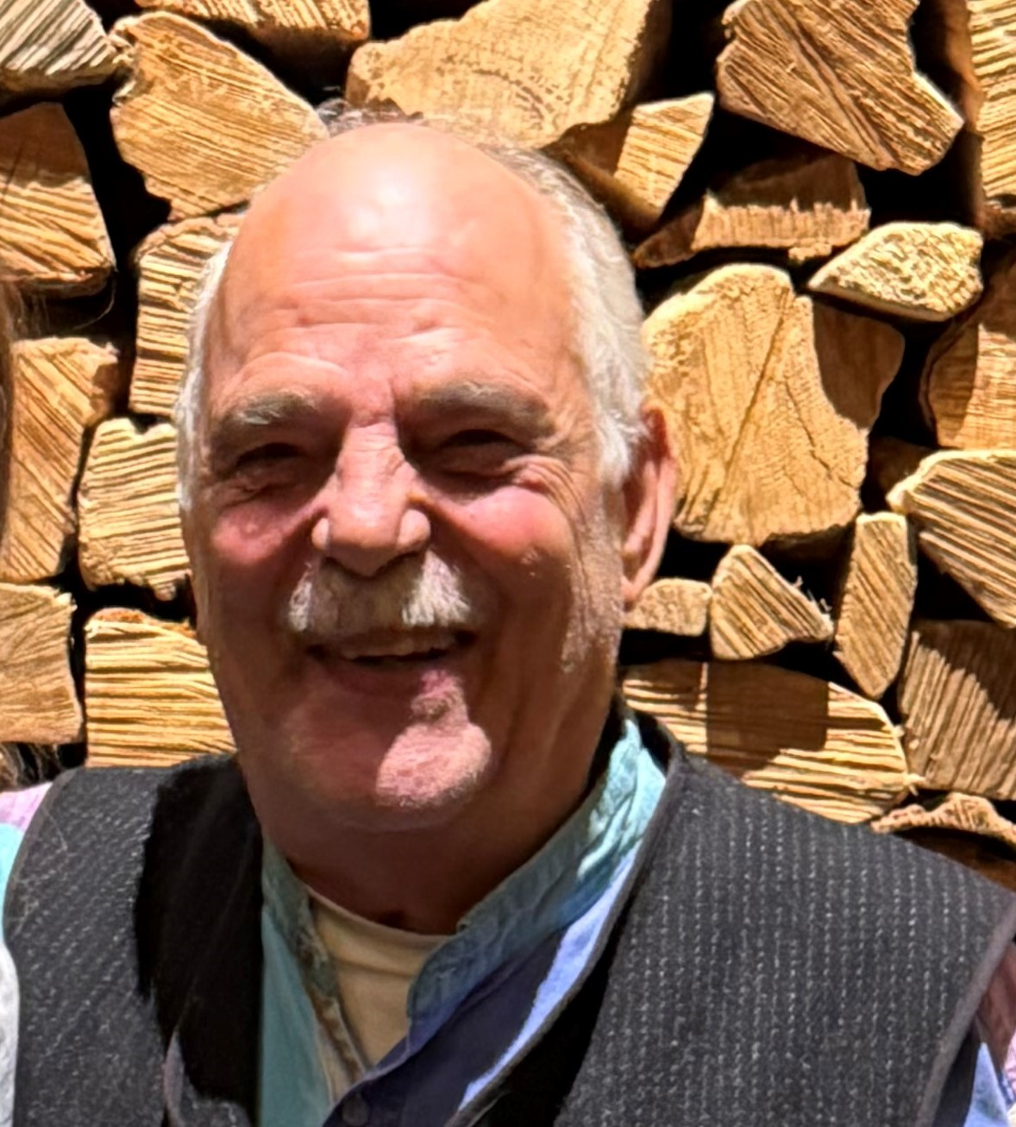
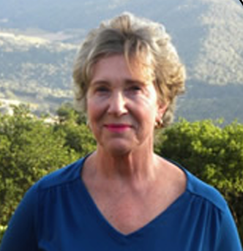
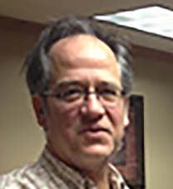
Finance Committee
Allan Benjamin has served as Board Treasurer for 5 years. As Treasurer, Allan chairs the Finance Committee.
Special thanks to these diligent and hard-working committee members – Brian Magaro, Pam Sullivan, and Eric Feutz – all past board Treasurers.
Notes:
We can thank Allan for his diligence and oversight to make sure we had a positive bottom line in 2025.
Financials are coming up next with the Treasurer

Slide 29
2026 Annual Meeting Agenda Continued
8 p.m. EST Voting closes
Door Prize Drawing (must be present to win)
5) Treasurer’s Report – Allan Benjamin, Treasurer - 15 min.
a. 2025 Balance Sheet, Revenue & Expense Statement (vote for approval)
b. Presentation of the 2026 Budget

Slide 30
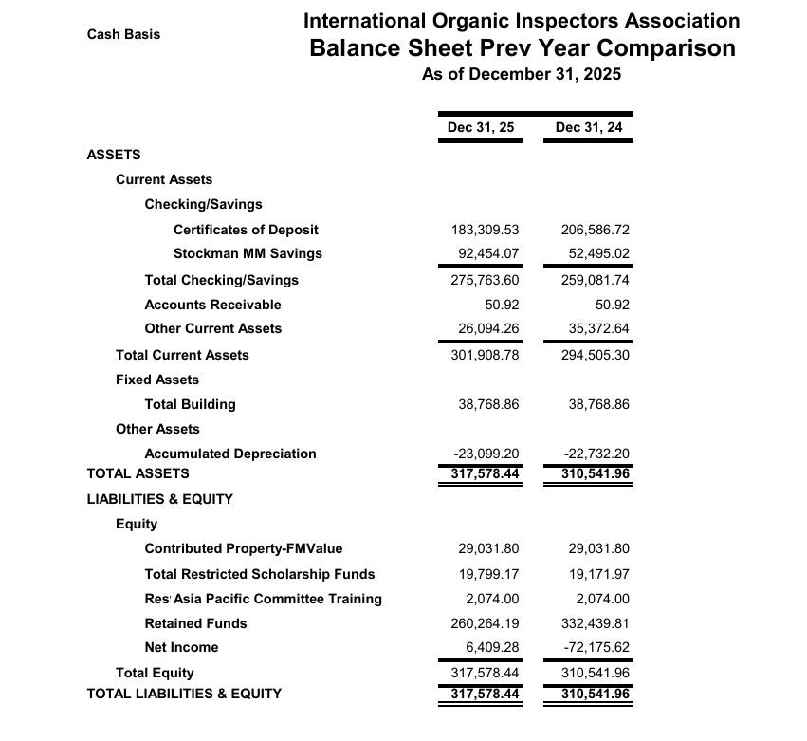
Balance
Sheet

Slide 31
Four-year Trend
 | 2022 | 2023 | 2024 | 2025
Current Assets | 439,262 | 367,771 | 294,505 | 310,909
Fixed Assets | 38,769 | 38,769 | 38,769 | 38,769
Other Assets (Accumulated Depreciation) | -21,542 | -21,542 | -22,732 | -23,099
Total Restricted Funds (Scholarship Funds) | 17,604 | 21,129 | 21,746 | 21,873
Total Liabilities & Equity | 456,490 | 384,315 | 310,542 | 317,578

Slide 32
2026 Annual Meeting Agenda Continued
6) 2027 and 2028 AGM Locations and Format –15 min. (open discussion)
7) New Business, member discussions, topics decided during AGM - 25 min. (open discussion)
8) Announce New Board & Acknowledge outgoing BOD members – 5 min. Facilitator – Justin Hurley, Vice-Chair
9) Adjourn 9 p.m. EST

Slide 33
Thank you for attending the 2026 Annual Meeting!

